Slide 1
Advanced Topics
Notes:
To create Em dash above headline:
Same size and weight as the headline and set using a soft return.
PC: Em dash (—): Alt+Ctrl+ - (minus)
Mac: Em dash (—): Shift+Alt/Option+hyphen

Slide 2
Learning Objectives
Understand and apply Dynamic Programming techniques to solving problems
Knapsack Problem
Understand and apply the Greedy approach to solving problems
Prim’s Algorithm (find minimum spanning tree)
Dijkstra’s Algorithm (find shortest path distances)
Understand and apply Gale-Shapley Algorithm to solve stable matching problem

Slide 3
Agenda
Dynamic Programming
Knapsack Problem
Greedy Approach
Prim’s Algorithm (minimum spanning tree)
Dijkstra’s Algorithm (shortest path distance)
Stable matching problem
Gale-Shapley Algorithm
Summary

Slide 4
1. Backtracking – ADD!!
Notes:
To create Em dash above headline:
Same size and weight as the headline and set using a soft return.
PC: Em dash (—): Alt+Ctrl+ - (minus)
Mac: Em dash (—): Shift+Alt/Option+hyphen

Slide 5
1. Dynamic Programming
Notes:
To create Em dash above headline:
Same size and weight as the headline and set using a soft return.
PC: Em dash (—): Alt+Ctrl+ - (minus)
Mac: Em dash (—): Shift+Alt/Option+hyphen

Slide 6
Dynamic Programming
Dynamic Programming is a general algorithm approach for solving problems using the solutions of overlapping subproblems.

Slide 7
Dynamic Programming – Idea
Setup a recurrence relating a solution of larger instances to the solutions of smaller instances.
Solve smaller instances once.
Record solutions in a table.
Extract solutions to the initial instance from the table, i.e., use solutions of smaller instances to construct solutions of initial larger problem instance.

Slide 8
Dynamic Programming
Sounds familiar? Divide and Conquer?
What is the difference?
Dynamic programming can be thought of as (1) Divide and Conquer and (2) storing sub-solutions.
Why have both then?

Slide 9
Dynamic Programming
Divide-and-conquer algorithms are preferred when the sub-problems/instances are independent, e.g., merge sort.
Dynamic programming approach is better when the sub-problems/instances are dependent, i.e., the solution to a sub-problem may be needed multiple times.

Slide 10
Dynamic Programming
Hence saving solutions allow them to be reused rather than recomputed.
Trade-off space (more) for time (faster).
“Programming” here means “planning”

Slide 11
Dynamic Programming Approaches
Two basic approaches to Dynamic Programming:
Top-Down
Bottom-Up

Slide 12
Dynamic Programming Approaches
Top-Down
Start with a divide and conquer algorithm, and begin dividing recursively.
Only solve/recurse on a subproblem if the solution is not available in the table (→ dependency)
Save solutions to subproblems in a table.

Slide 13
Dynamic Programming Approaches
Bottom-Up
Study a recursive divide and conquer algorithm and figure out the dependencies between the subproblems.
Solve all subproblems, and then use solutions to subproblems to construct solutions to larger problems.

Slide 14
1a. Knapsack Problem (Bottom Up)
Notes:
To create Em dash above headline:
Same size and weight as the headline and set using a soft return.
PC: Em dash (—): Alt+Ctrl+ - (minus)
Mac: Em dash (—): Shift+Alt/Option+hyphen

Slide 15
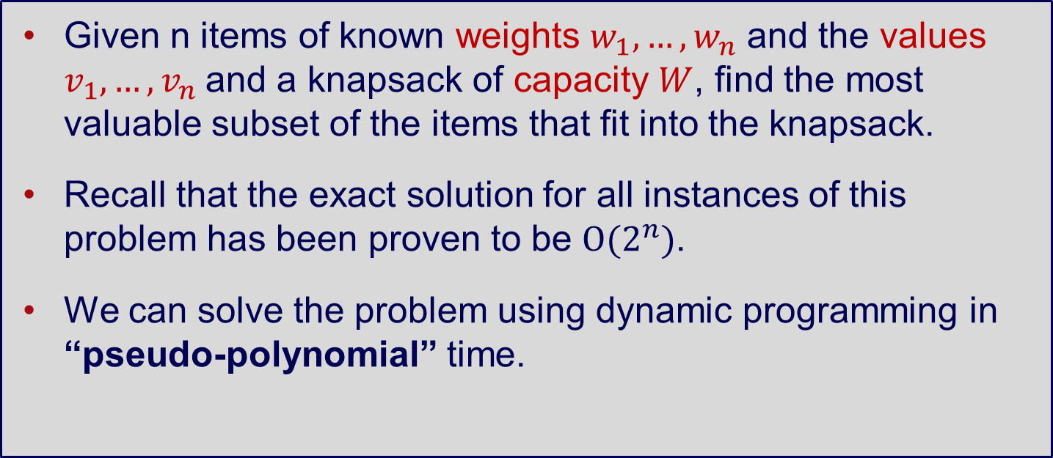
Knapsack Problem
Given n items of known weights $w_{1},…,w_{n}$ and the values $v_{1},…,v_{n}$and a knapsack of capacity $W$, find the most valuable subset of the items that fit into the knapsack.
Recall that the exact solution for all instances of this problem has been proven to be $O(2^{n})$.
We can solve the problem using dynamic programming in “pseudo-polynomial” time.

Slide 16
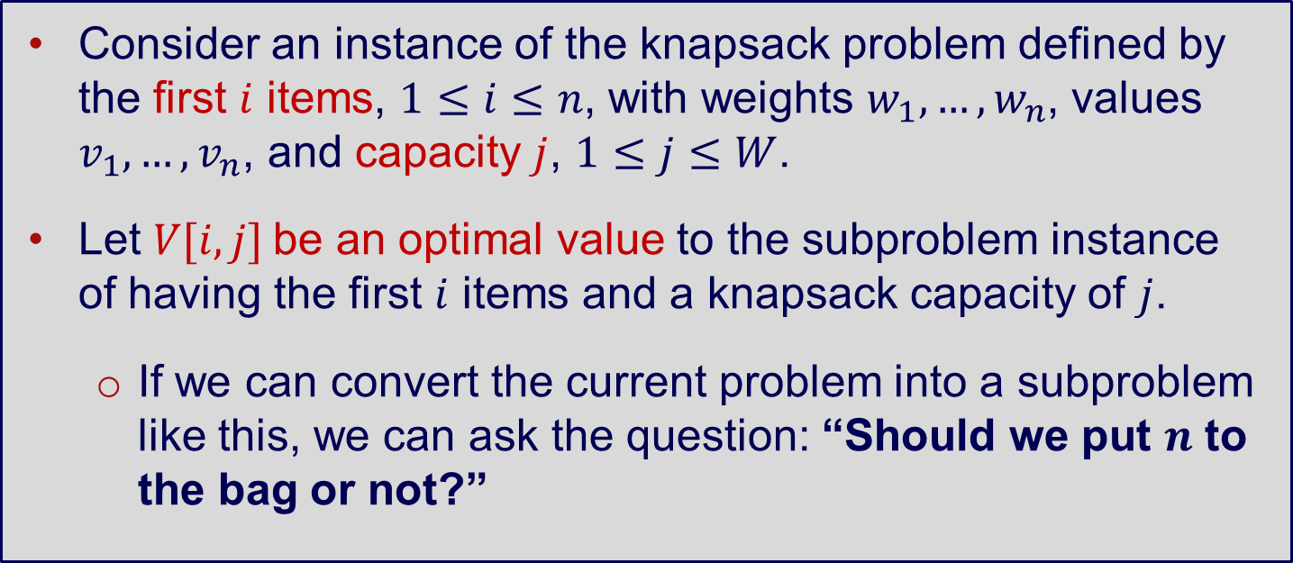
Knapsack Problem – DP Sketch
Consider an instance of the knapsack problem defined by the first $i$ items, $1≤i≤n$, with weights $w_{1},…,w_{n}$, values $v_{1},…,v_{n}$, and capacity $j$, $1≤j≤W$.
Let $V[i,j]$be an optimal value to the subproblem instance of having the first $i$ items and a knapsack capacity of $j$.
If we can convert the current problem into a subproblem like this, we can ask the question: “Should we put $n$ to the bag or not?”

Slide 17
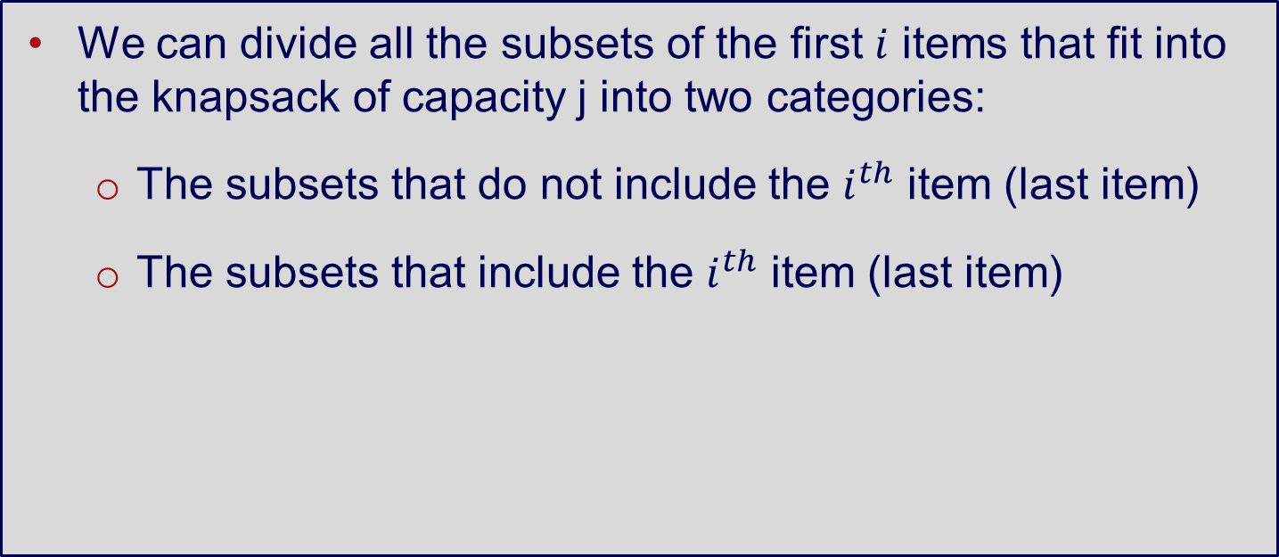
Knapsack Problem – DP Sketch
We can divide all the subsets of the first $i$ items that fit into the knapsack of capacity j into two categories:
The subsets that do not include the $i^{th}$ item (last item)
The subsets that include the $i^{th}$ item (last item)

Slide 18
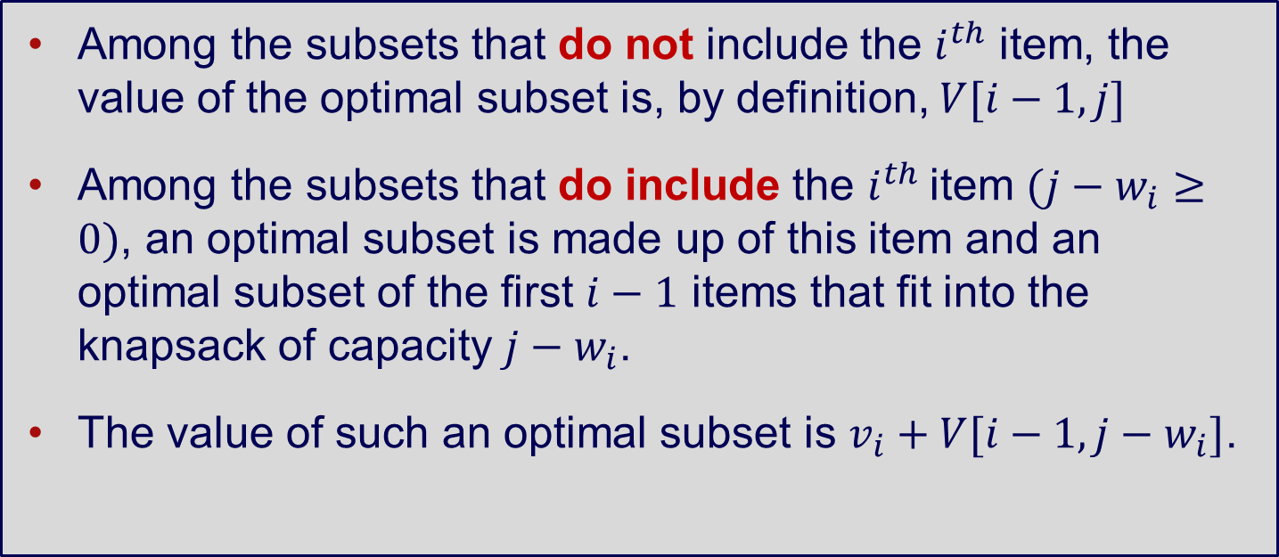
Knapsack Problem – DP Sketch
Among the subsets that do not include the $i^{th}$ item, the value of the optimal subset is, by definition, $V[i−1, j]$
Among the subsets that do include the $i^{th}$item $(j−w_{i}≥0)$, an optimal subset is made up of this item and an optimal subset of the first $i−1$ items that fit into the knapsack of capacity $j−w_{i}$.
The value of such an optimal subset is $v_{i}+V[i−1, j−w_{i}]$.
Notes:
Because we don’t consider the last item in our bag, the number of items for the optimal value V is i-1, while the capacity stays the same as j
Because we consider the last item, the optimal value is {value of ith item} + optimal value without the ith item while the capacity should big enough to contain the weight of item ith

Slide 19
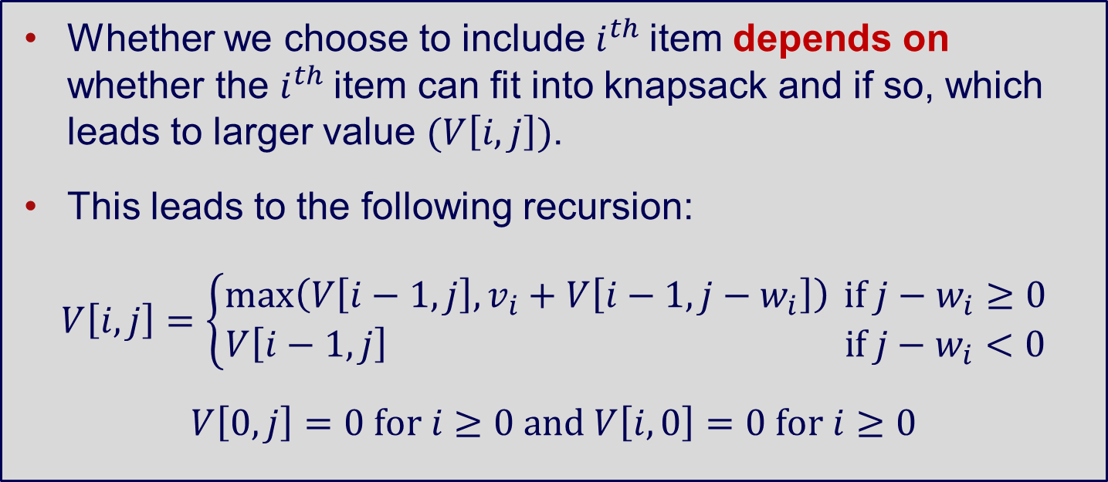
Knapsack Problem – DP Sketch
Whether we choose to include $i^{th}$item depends on whether the $i^{th}$item can fit into knapsack and if so, which leads to larger value $(V\left[i,j\right])$.
This leads to the following recursion:
$$V\left[i,j\right]=\left\{\begin{aligned}\max\left(V\left[i−1,j\right],v_{i}+V\left[i−1,j−w_{i}\right]\right) if j−w_{i}≥0 \\ V\left[i−1,j\right] if j−w_{i}<0\end{aligned}\right.$$
$$V\left[0,j\right]=0 for i≥0 and V\left[i,0\right]=0 for i≥0$$
Notes:
Simply put: if the bag is large enough to contain item ith with weight wi (j – wi >= 0), then we choose the option that yields the max value (to put or not to put the ith item)
Otherwise if the bag is not large enough, forget about it, we cannot put item ith in which leads to the only option V[i-1, j]

Slide 20
Bottom-Up DP algorithm
Bottom-up Dynamic Programming: What we have been doing up to this point, computing solutions to all entries in the dynamic programming table.
Use an example to illustrate the table filling process.

Slide 21
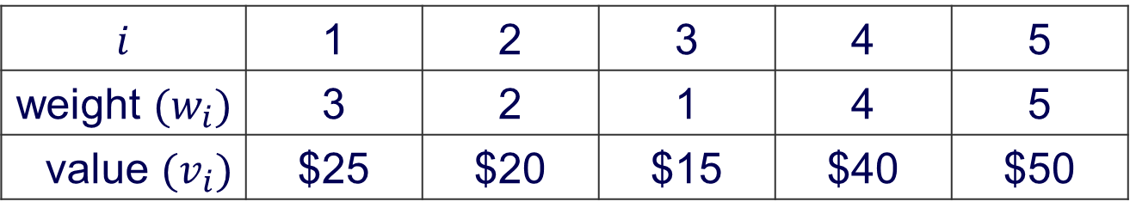
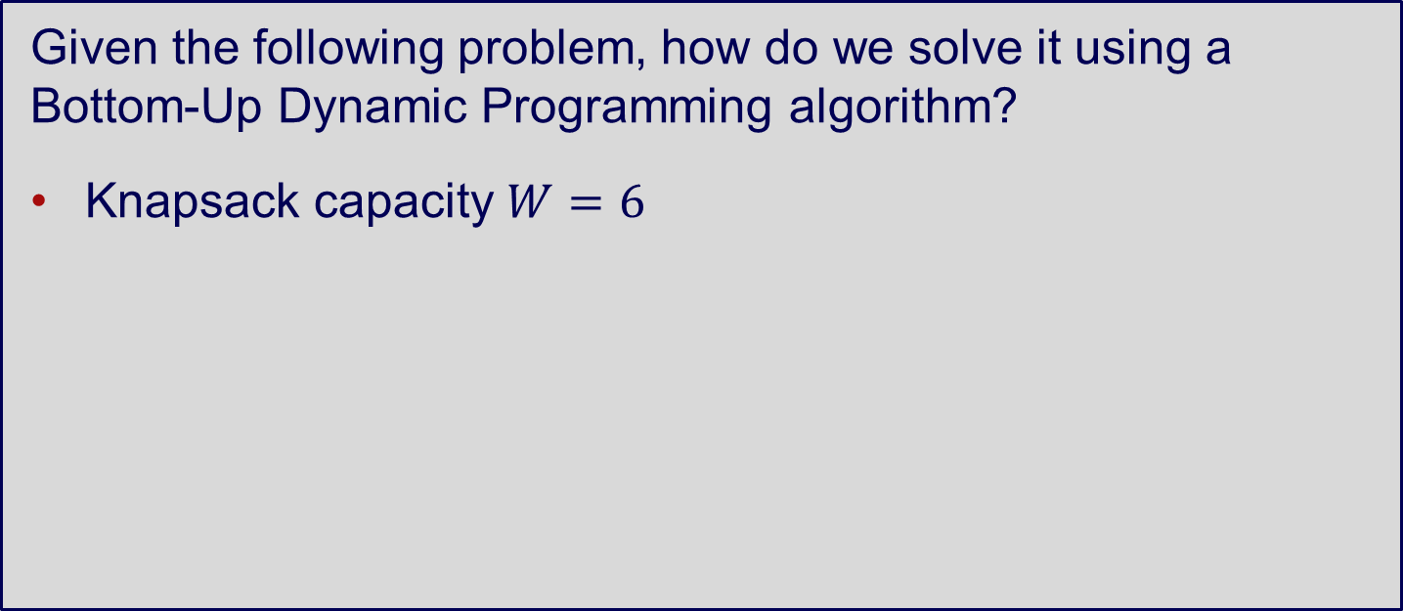
Bottom-Up DP algorithm
Given the following problem, how do we solve it using a Bottom-Up Dynamic Programming algorithm?
Knapsack capacity $W=6$
$$i$$ | 1 | 2 | 3 | 4 | 5
weight $(w_{i})$ | 3 | 2 | 1 | 4 | 5
value $(v_{i})$ | $25 | $20 | $15 | $40 | $50

Slide 22
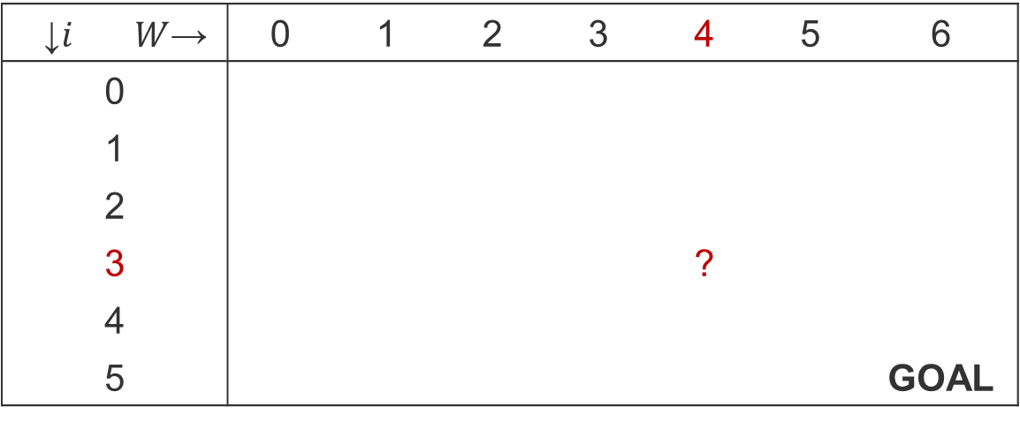
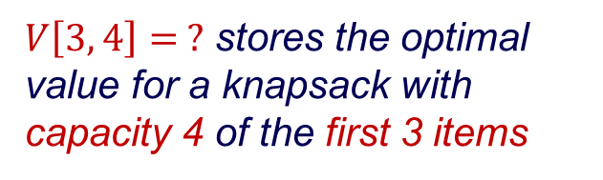
Bottom-Up DP algorithm
We record the solutions to each smaller problems in table.
↓$i$ | $W$→ | 0 | 1 | 2 | 3 | 4 | 5 | 6
0
1
2
3 |  |  |  |  |  | ?
4
5 |  |  |  |  |  |  |  | GOAL
$V\left[3, 4\right]= ?$ stores the optimal value for a knapsack with capacity 4 of the first 3 items
Notes:
Goal here refers to the maximum capacity of 6

Slide 23
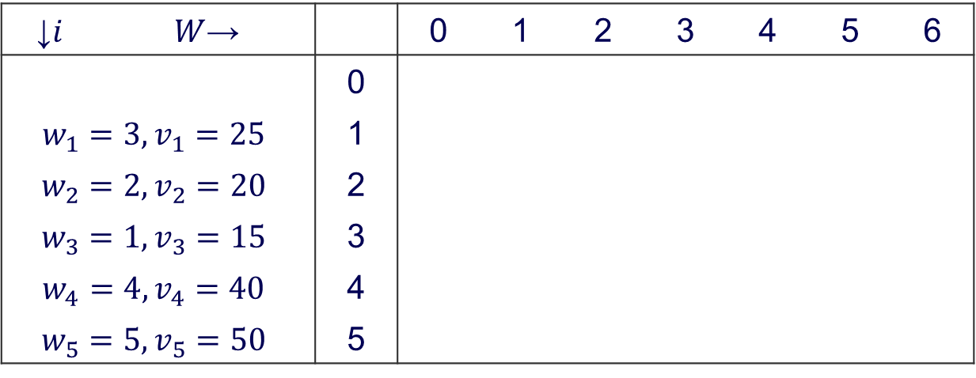
Bottom-Up DP algorithm
$$V\left[i,j\right]=\left\{\begin{aligned}\max\left(V\left[i−1,j\right],v_{i}+V\left[i−1,j−w_{i}\right]\right) if j−w_{i}≥0 \\ V\left[i−1,j\right] if j−w_{i}<0\end{aligned}\right.$$
$$V\left[0,j\right]=0 for i≥0 and V\left[i,0\right]=0 for i≥0$$
↓$i$ | $W$→ |  | 0 | 1 | 2 | 3 | 4 | 5 | 6
 |  | 0
$$w_{1}=3, v_{1}=25$$ |  | 1
$$w_{2}=2, v_{2}=20$$ |  | 2
$$w_{3}=1, v_{3}=15$$ |  | 3
$$w_{4}=4, v_{4}=40$$ |  | 4
$$w_{5}=5, v_{5}=50$$ |  | 5

Slide 24
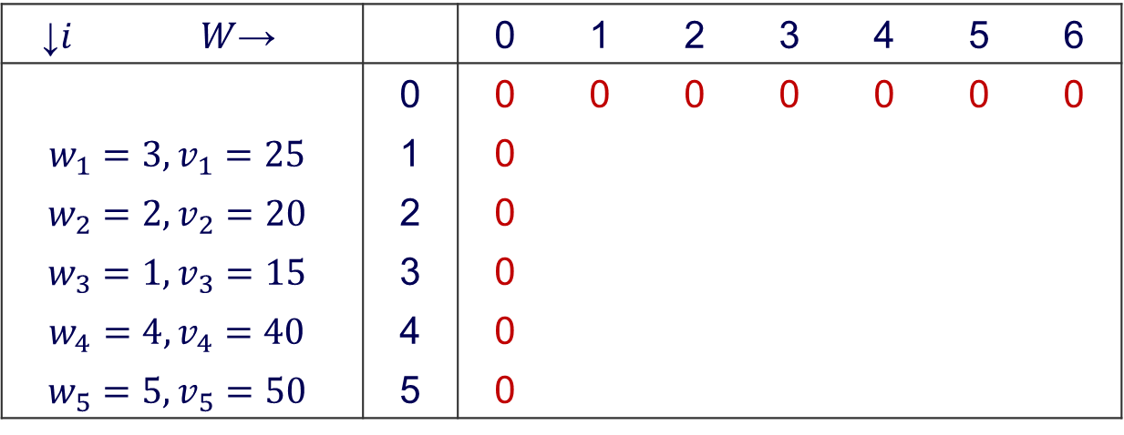
Bottom-Up DP algorithm
$$V\left[i,j\right]=\left\{\begin{aligned}\max\left(V\left[i−1,j\right],v_{i}+V\left[i−1,j−w_{i}\right]\right) if j−w_{i}≥0 \\ V\left[i−1,j\right] if j−w_{i}<0\end{aligned}\right.$$
$$V\left[0,j\right]=0 for i≥0 and V\left[i,0\right]=0 for i≥0$$
↓$i$ | $W$→ |  | 0 | 1 | 2 | 3 | 4 | 5 | 6
 |  | 0 | 0 | 0 | 0 | 0 | 0 | 0 | 0
$$w_{1}=3, v_{1}=25$$ |  | 1 | 0
$$w_{2}=2, v_{2}=20$$ |  | 2 | 0
$$w_{3}=1, v_{3}=15$$ |  | 3 | 0
$$w_{4}=4, v_{4}=40$$ |  | 4 | 0
$$w_{5}=5, v_{5}=50$$ |  | 5 | 0

Slide 25
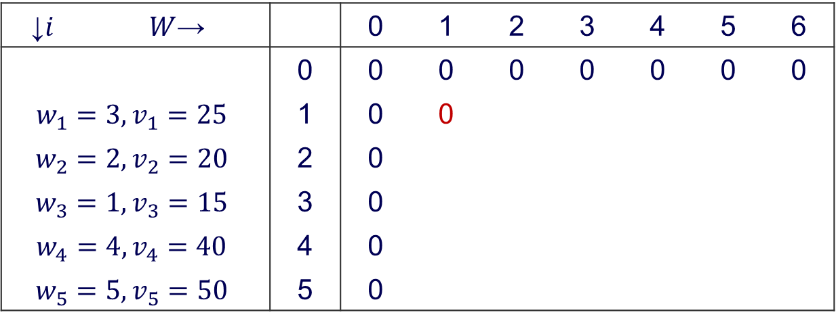
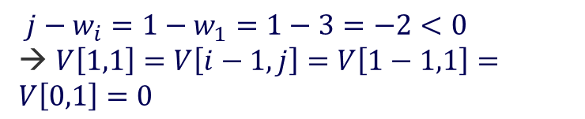
Bottom-Up DP algorithm
$$V\left[i,j\right]=\left\{\begin{aligned}\max\left(V\left[i−1,j\right],v_{i}+V\left[i−1,j−w_{i}\right]\right) if j−w_{i}≥0 \\ V\left[i−1,j\right] if j−w_{i}<0\end{aligned}\right.$$
$$V\left[0,j\right]=0 for i≥0 and V\left[i,0\right]=0 for i≥0$$
↓$i$ | $W$→ |  | 0 | 1 | 2 | 3 | 4 | 5 | 6
 |  | 0 | 0 | 0 | 0 | 0 | 0 | 0 | 0
$$w_{1}=3, v_{1}=25$$ |  | 1 | 0 | 0
$$w_{2}=2, v_{2}=20$$ |  | 2 | 0
$$w_{3}=1, v_{3}=15$$ |  | 3 | 0
$$w_{4}=4, v_{4}=40$$ |  | 4 | 0
$$w_{5}=5, v_{5}=50$$ |  | 5 | 0
Calculating value for $V[1,1]$; $i=1, j=1$
$$j−w_{i}=1−w_{1}=1−3=−2<0$$
→ $V\left[1,1\right]=V\left[i−1,j\right]=V\left[1−1,1\right]=V\left[0,1\right]=0$

Slide 26
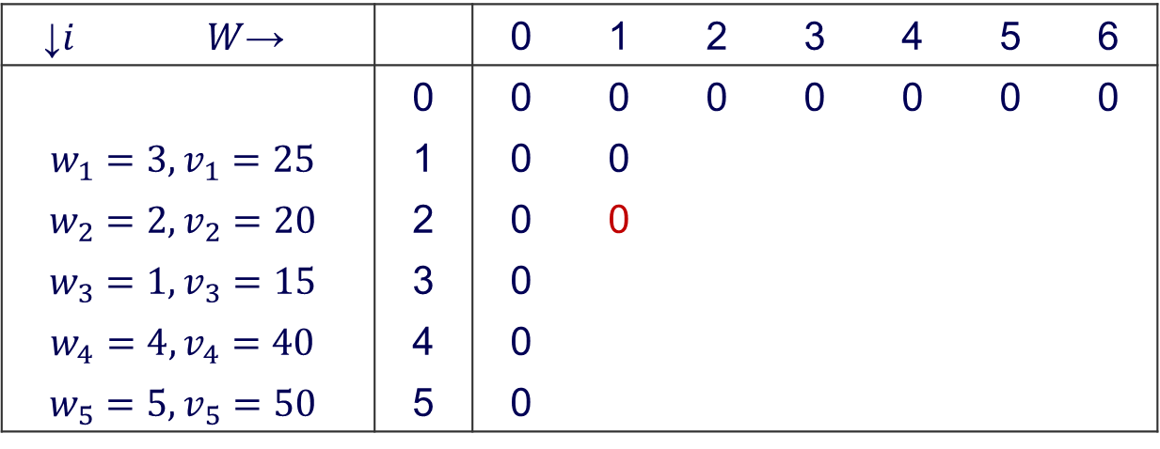
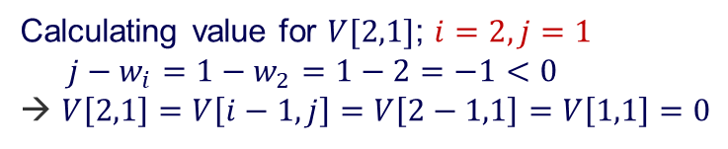
Bottom-Up DP algorithm
$$V\left[i,j\right]=\left\{\begin{aligned}\max\left(V\left[i−1,j\right],v_{i}+V\left[i−1,j−w_{i}\right]\right) if j−w_{i}≥0 \\ V\left[i−1,j\right] if j−w_{i}<0\end{aligned}\right.$$
$$V\left[0,j\right]=0 for i≥0 and V\left[i,0\right]=0 for i≥0$$
↓$i$ | $W$→ |  | 0 | 1 | 2 | 3 | 4 | 5 | 6
 |  | 0 | 0 | 0 | 0 | 0 | 0 | 0 | 0
$$w_{1}=3, v_{1}=25$$ |  | 1 | 0 | 0
$$w_{2}=2, v_{2}=20$$ |  | 2 | 0 | 0
$$w_{3}=1, v_{3}=15$$ |  | 3 | 0
$$w_{4}=4, v_{4}=40$$ |  | 4 | 0
$$w_{5}=5, v_{5}=50$$ |  | 5 | 0
Calculating value for $V[2,1]$; $i=2, j=1$
$$j−w_{i}=1−w_{2}=1−2=−1<0$$
→ $V\left[2,1\right]=V\left[i−1,j\right]=V\left[2−1,1\right]=V\left[1,1\right]=0$

Slide 27
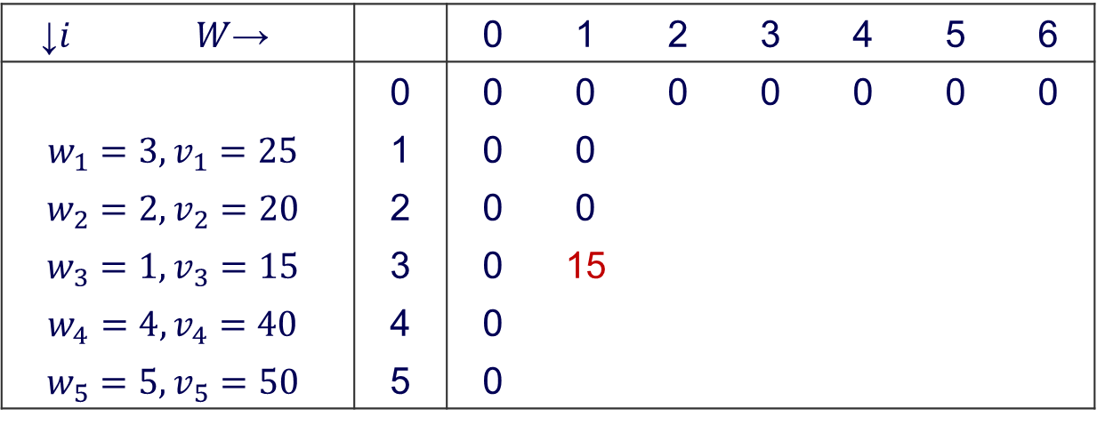
Bottom-Up DP algorithm
$$V\left[i,j\right]=\left\{\begin{aligned}\max\left(V\left[i−1,j\right],v_{i}+V\left[i−1,j−w_{i}\right]\right) if j−w_{i}≥0 \\ V\left[i−1,j\right] if j−w_{i}<0\end{aligned}\right.$$
$$V\left[0,j\right]=0 for i≥0 and V\left[i,0\right]=0 for i≥0$$
↓$i$ | $W$→ |  | 0 | 1 | 2 | 3 | 4 | 5 | 6
 |  | 0 | 0 | 0 | 0 | 0 | 0 | 0 | 0
$$w_{1}=3, v_{1}=25$$ |  | 1 | 0 | 0
$$w_{2}=2, v_{2}=20$$ |  | 2 | 0 | 0
$$w_{3}=1, v_{3}=15$$ |  | 3 | 0 | 15
$$w_{4}=4, v_{4}=40$$ |  | 4 | 0
$$w_{5}=5, v_{5}=50$$ |  | 5 | 0
Calculating value for $V[3,1]$; $i=3, j=1$
Notes:
V[3,1] = max(V[3-1,1], v3 + V[3-1,1-w3]) = max(V[2,1], 15 + V[2,0]) = max(0, 15) = 15
Draw the bag here, we have a bag capacity of 1 (W=1), do we consider to put item 3rd (w3) in the bag or not. The weight will be j – w3 = 1 – 1 = 0

Slide 28
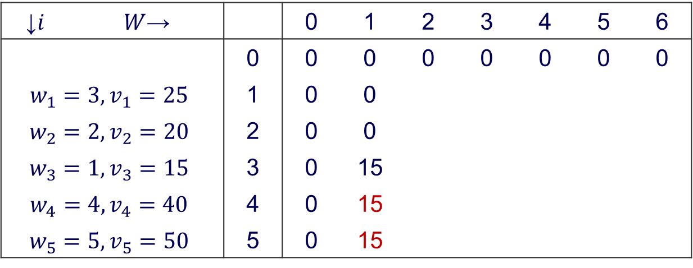
Bottom-Up DP algorithm
$$V\left[i,j\right]=\left\{\begin{aligned}\max\left(V\left[i−1,j\right],v_{i}+V\left[i−1,j−w_{i}\right]\right) if j−w_{i}≥0 \\ V\left[i−1,j\right] if j−w_{i}<0\end{aligned}\right.$$
$$V\left[0,j\right]=0 for i≥0 and V\left[i,0\right]=0 for i≥0$$
↓$i$ | $W$→ |  | 0 | 1 | 2 | 3 | 4 | 5 | 6
 |  | 0 | 0 | 0 | 0 | 0 | 0 | 0 | 0
$$w_{1}=3, v_{1}=25$$ |  | 1 | 0 | 0
$$w_{2}=2, v_{2}=20$$ |  | 2 | 0 | 0
$$w_{3}=1, v_{3}=15$$ |  | 3 | 0 | 15
$$w_{4}=4, v_{4}=40$$ |  | 4 | 0 | 15
$$w_{5}=5, v_{5}=50$$ |  | 5 | 0 | 15

Slide 29
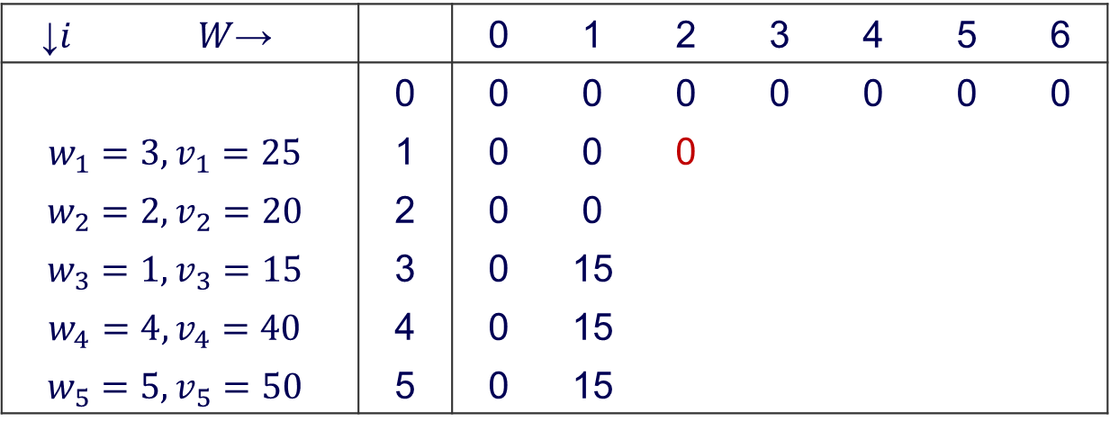
Bottom-Up DP algorithm
$$V\left[i,j\right]=\left\{\begin{aligned}\max\left(V\left[i−1,j\right],v_{i}+V\left[i−1,j−w_{i}\right]\right) if j−w_{i}≥0 \\ V\left[i−1,j\right] if j−w_{i}<0\end{aligned}\right.$$
$$V\left[0,j\right]=0 for i≥0 and V\left[i,0\right]=0 for i≥0$$
↓$i$ | $W$→ |  | 0 | 1 | 2 | 3 | 4 | 5 | 6
 |  | 0 | 0 | 0 | 0 | 0 | 0 | 0 | 0
$$w_{1}=3, v_{1}=25$$ |  | 1 | 0 | 0 | 0
$$w_{2}=2, v_{2}=20$$ |  | 2 | 0 | 0
$$w_{3}=1, v_{3}=15$$ |  | 3 | 0 | 15
$$w_{4}=4, v_{4}=40$$ |  | 4 | 0 | 15
$$w_{5}=5, v_{5}=50$$ |  | 5 | 0 | 15

Slide 30
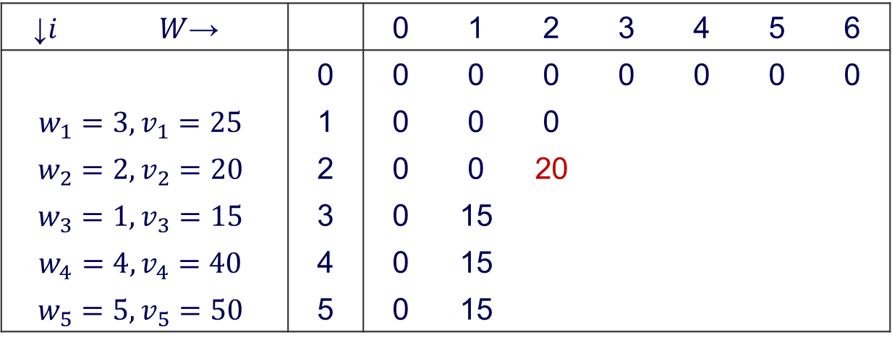

Bottom-Up DP algorithm
$$V\left[i,j\right]=\left\{\begin{aligned}\max\left(V\left[i−1,j\right],v_{i}+V\left[i−1,j−w_{i}\right]\right) if j−w_{i}≥0 \\ V\left[i−1,j\right] if j−w_{i}<0\end{aligned}\right.$$
$$V\left[0,j\right]=0 for i≥0 and V\left[i,0\right]=0 for i≥0$$
↓$i$ | $W$→ |  | 0 | 1 | 2 | 3 | 4 | 5 | 6
 |  | 0 | 0 | 0 | 0 | 0 | 0 | 0 | 0
$$w_{1}=3, v_{1}=25$$ |  | 1 | 0 | 0 | 0
$$w_{2}=2, v_{2}=20$$ |  | 2 | 0 | 0 | 20
$$w_{3}=1, v_{3}=15$$ |  | 3 | 0 | 15
$$w_{4}=4, v_{4}=40$$ |  | 4 | 0 | 15
$$w_{5}=5, v_{5}=50$$ |  | 5 | 0 | 15
Calculating $V[2, 2]$; $i=2, j=2$

Slide 31
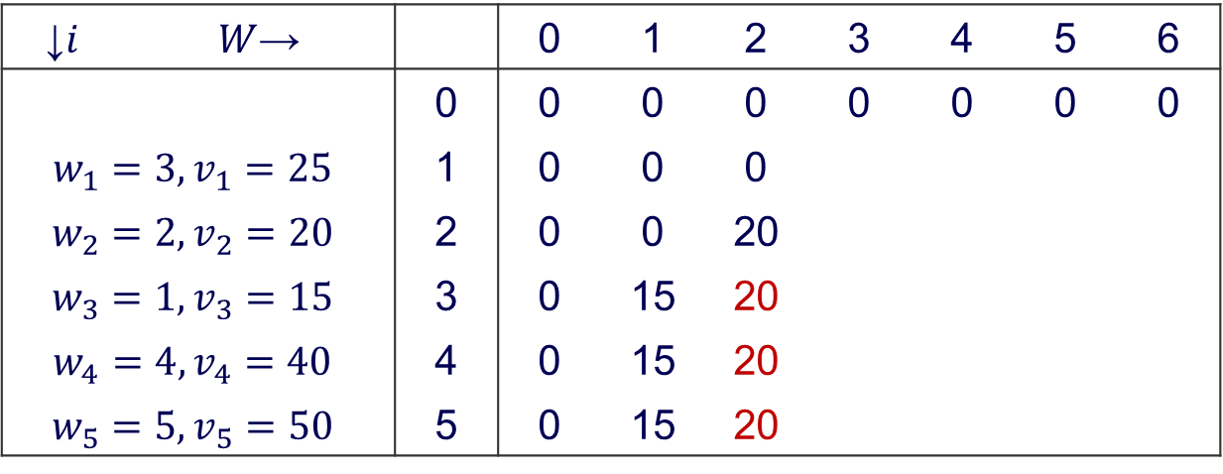
Bottom-Up DP algorithm
$$V\left[i,j\right]=\left\{\begin{aligned}\max\left(V\left[i−1,j\right],v_{i}+V\left[i−1,j−w_{i}\right]\right) if j−w_{i}≥0 \\ V\left[i−1,j\right] if j−w_{i}<0\end{aligned}\right.$$
$$V\left[0,j\right]=0 for i≥0 and V\left[i,0\right]=0 for i≥0$$
↓$i$ | $W$→ |  | 0 | 1 | 2 | 3 | 4 | 5 | 6
 |  | 0 | 0 | 0 | 0 | 0 | 0 | 0 | 0
$$w_{1}=3, v_{1}=25$$ |  | 1 | 0 | 0 | 0
$$w_{2}=2, v_{2}=20$$ |  | 2 | 0 | 0 | 20
$$w_{3}=1, v_{3}=15$$ |  | 3 | 0 | 15 | 20
$$w_{4}=4, v_{4}=40$$ |  | 4 | 0 | 15 | 20
$$w_{5}=5, v_{5}=50$$ |  | 5 | 0 | 15 | 20

Slide 32
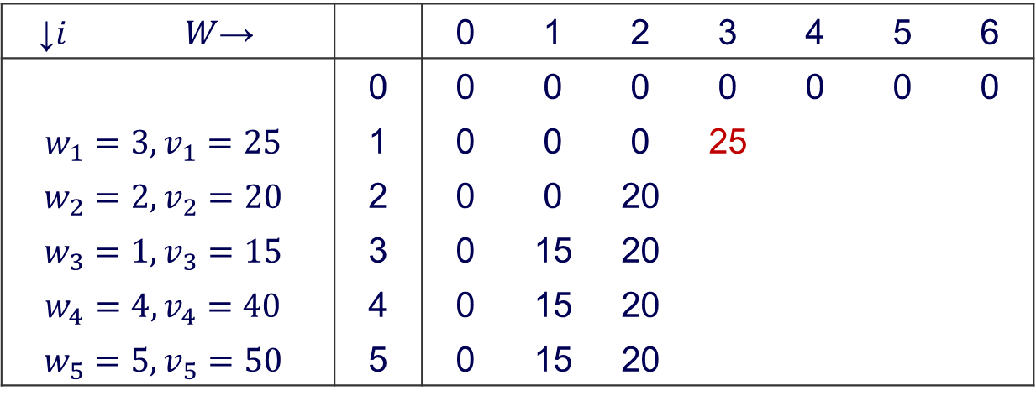
Bottom-Up DP algorithm
$$V\left[i,j\right]=\left\{\begin{aligned}\max\left(V\left[i−1,j\right],v_{i}+V\left[i−1,j−w_{i}\right]\right) if j−w_{i}≥0 \\ V\left[i−1,j\right] if j−w_{i}<0\end{aligned}\right.$$
$$V\left[0,j\right]=0 for i≥0 and V\left[i,0\right]=0 for i≥0$$
↓$i$ | $W$→ |  | 0 | 1 | 2 | 3 | 4 | 5 | 6
 |  | 0 | 0 | 0 | 0 | 0 | 0 | 0 | 0
$$w_{1}=3, v_{1}=25$$ |  | 1 | 0 | 0 | 0 | 25
$$w_{2}=2, v_{2}=20$$ |  | 2 | 0 | 0 | 20
$$w_{3}=1, v_{3}=15$$ |  | 3 | 0 | 15 | 20
$$w_{4}=4, v_{4}=40$$ |  | 4 | 0 | 15 | 20
$$w_{5}=5, v_{5}=50$$ |  | 5 | 0 | 15 | 20

Slide 33
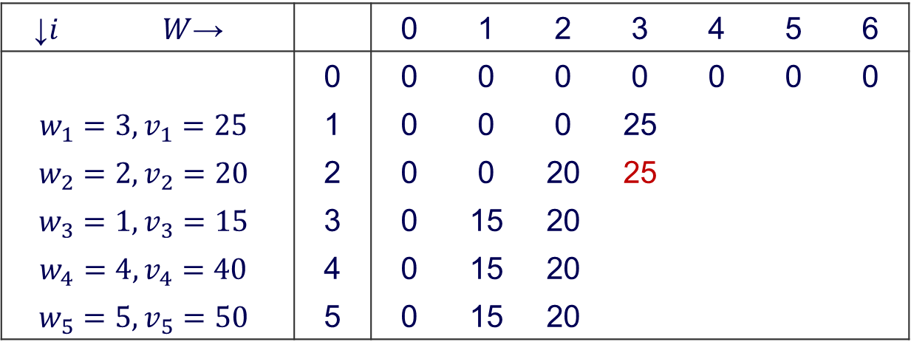
Bottom-Up DP algorithm
$$V\left[i,j\right]=\left\{\begin{aligned}\max\left(V\left[i−1,j\right],v_{i}+V\left[i−1,j−w_{i}\right]\right) if j−w_{i}≥0 \\ V\left[i−1,j\right] if j−w_{i}<0\end{aligned}\right.$$
$$V\left[0,j\right]=0 for i≥0 and V\left[i,0\right]=0 for i≥0$$
↓$i$ | $W$→ |  | 0 | 1 | 2 | 3 | 4 | 5 | 6
 |  | 0 | 0 | 0 | 0 | 0 | 0 | 0 | 0
$$w_{1}=3, v_{1}=25$$ |  | 1 | 0 | 0 | 0 | 25
$$w_{2}=2, v_{2}=20$$ |  | 2 | 0 | 0 | 20 | 25
$$w_{3}=1, v_{3}=15$$ |  | 3 | 0 | 15 | 20
$$w_{4}=4, v_{4}=40$$ |  | 4 | 0 | 15 | 20
$$w_{5}=5, v_{5}=50$$ |  | 5 | 0 | 15 | 20

Slide 34
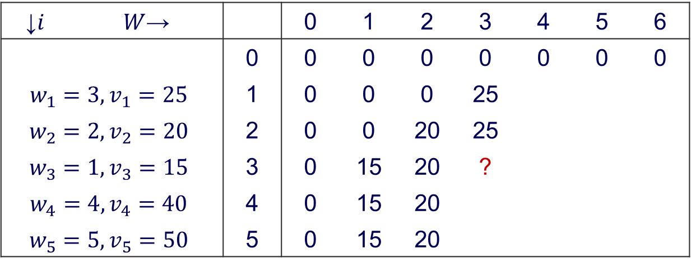
Bottom-Up DP algorithm
$$V\left[i,j\right]=\left\{\begin{aligned}\max\left(V\left[i−1,j\right],v_{i}+V\left[i−1,j−w_{i}\right]\right) if j−w_{i}≥0 \\ V\left[i−1,j\right] if j−w_{i}<0\end{aligned}\right.$$
$$V\left[0,j\right]=0 for i≥0 and V\left[i,0\right]=0 for i≥0$$
↓$i$ | $W$→ |  | 0 | 1 | 2 | 3 | 4 | 5 | 6
 |  | 0 | 0 | 0 | 0 | 0 | 0 | 0 | 0
$$w_{1}=3, v_{1}=25$$ |  | 1 | 0 | 0 | 0 | 25
$$w_{2}=2, v_{2}=20$$ |  | 2 | 0 | 0 | 20 | 25
$$w_{3}=1, v_{3}=15$$ |  | 3 | 0 | 15 | 20 | ?
$$w_{4}=4, v_{4}=40$$ |  | 4 | 0 | 15 | 20
$$w_{5}=5, v_{5}=50$$ |  | 5 | 0 | 15 | 20

Slide 35
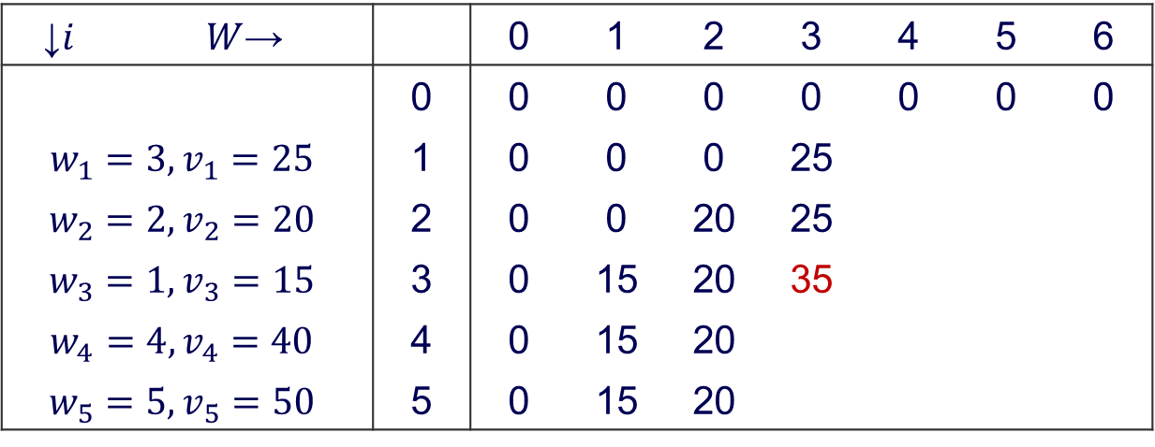
Bottom-Up DP algorithm
$$V\left[i,j\right]=\left\{\begin{aligned}\max\left(V\left[i−1,j\right],v_{i}+V\left[i−1,j−w_{i}\right]\right) if j−w_{i}≥0 \\ V\left[i−1,j\right] if j−w_{i}<0\end{aligned}\right.$$
$$V\left[0,j\right]=0 for i≥0 and V\left[i,0\right]=0 for i≥0$$
↓$i$ | $W$→ |  | 0 | 1 | 2 | 3 | 4 | 5 | 6
 |  | 0 | 0 | 0 | 0 | 0 | 0 | 0 | 0
$$w_{1}=3, v_{1}=25$$ |  | 1 | 0 | 0 | 0 | 25
$$w_{2}=2, v_{2}=20$$ |  | 2 | 0 | 0 | 20 | 25
$$w_{3}=1, v_{3}=15$$ |  | 3 | 0 | 15 | 20 | 35
$$w_{4}=4, v_{4}=40$$ |  | 4 | 0 | 15 | 20
$$w_{5}=5, v_{5}=50$$ |  | 5 | 0 | 15 | 20

Slide 36
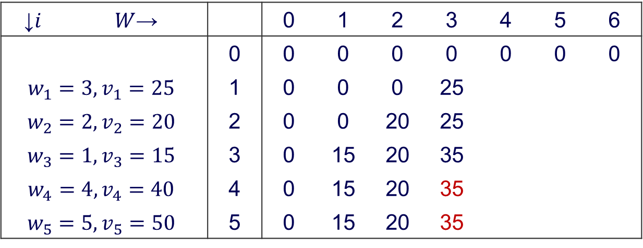
Bottom-Up DP algorithm
$$V\left[i,j\right]=\left\{\begin{aligned}\max\left(V\left[i−1,j\right],v_{i}+V\left[i−1,j−w_{i}\right]\right) if j−w_{i}≥0 \\ V\left[i−1,j\right] if j−w_{i}<0\end{aligned}\right.$$
$$V\left[0,j\right]=0 for i≥0 and V\left[i,0\right]=0 for i≥0$$
↓$i$ | $W$→ |  | 0 | 1 | 2 | 3 | 4 | 5 | 6
 |  | 0 | 0 | 0 | 0 | 0 | 0 | 0 | 0
$$w_{1}=3, v_{1}=25$$ |  | 1 | 0 | 0 | 0 | 25
$$w_{2}=2, v_{2}=20$$ |  | 2 | 0 | 0 | 20 | 25
$$w_{3}=1, v_{3}=15$$ |  | 3 | 0 | 15 | 20 | 35
$$w_{4}=4, v_{4}=40$$ |  | 4 | 0 | 15 | 20 | 35
$$w_{5}=5, v_{5}=50$$ |  | 5 | 0 | 15 | 20 | 35
Notes:
Here we attempt to put 4 and 5 items in the bag with a capacity of only 3. Both of these items have weights equal to 4 and 5, so cannot fit. The best option remains 20 + 15 = 35

Slide 37
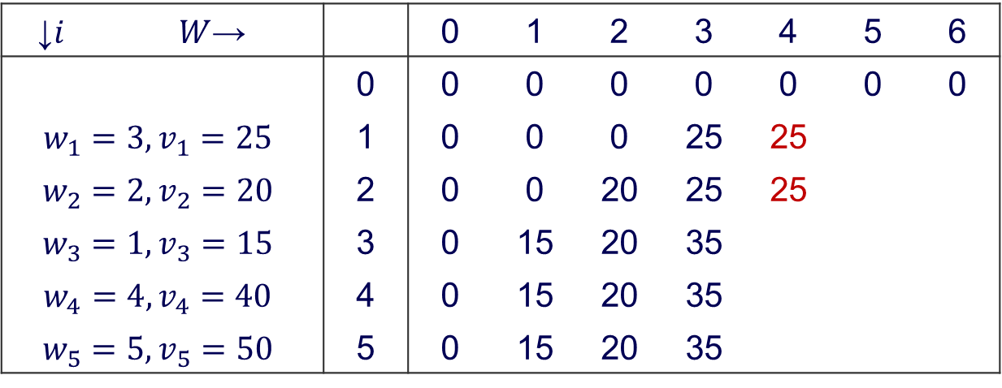
Bottom-Up DP algorithm
$$V\left[i,j\right]=\left\{\begin{aligned}\max\left(V\left[i−1,j\right],v_{i}+V\left[i−1,j−w_{i}\right]\right) if j−w_{i}≥0 \\ V\left[i−1,j\right] if j−w_{i}<0\end{aligned}\right.$$
$$V\left[0,j\right]=0 for i≥0 and V\left[i,0\right]=0 for i≥0$$
↓$i$ | $W$→ |  | 0 | 1 | 2 | 3 | 4 | 5 | 6
 |  | 0 | 0 | 0 | 0 | 0 | 0 | 0 | 0
$$w_{1}=3, v_{1}=25$$ |  | 1 | 0 | 0 | 0 | 25 | 25
$$w_{2}=2, v_{2}=20$$ |  | 2 | 0 | 0 | 20 | 25 | 25
$$w_{3}=1, v_{3}=15$$ |  | 3 | 0 | 15 | 20 | 35
$$w_{4}=4, v_{4}=40$$ |  | 4 | 0 | 15 | 20 | 35
$$w_{5}=5, v_{5}=50$$ |  | 5 | 0 | 15 | 20 | 35
Notes:
Here we attempt to put 2 items in a bag with capacity of 4. We cannot put two items because total weight will be w1 + w2 = 5. So the best option remains 25.

Slide 38
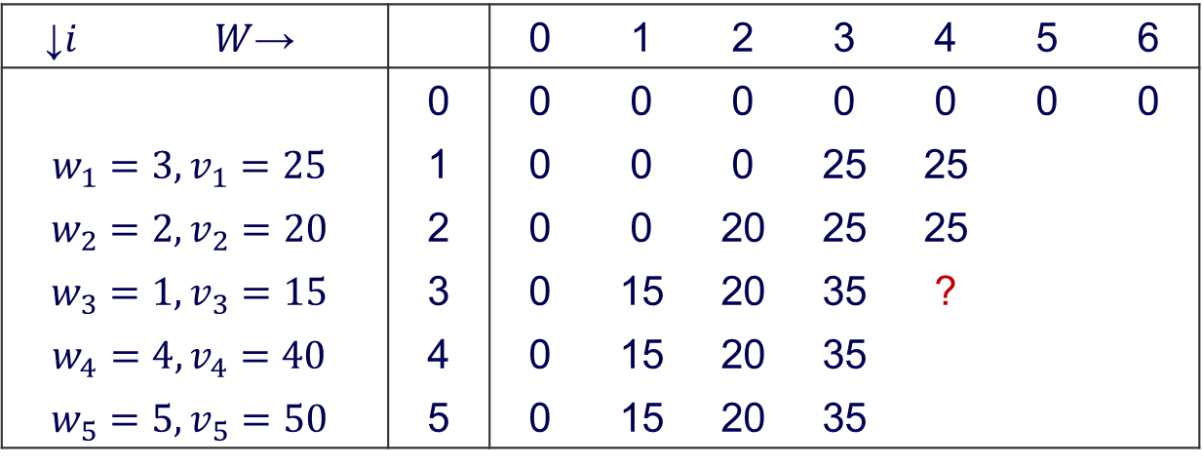
Bottom-Up DP algorithm
$$V\left[i,j\right]=\left\{\begin{aligned}\max\left(V\left[i−1,j\right],v_{i}+V\left[i−1,j−w_{i}\right]\right) if j−w_{i}≥0 \\ V\left[i−1,j\right] if j−w_{i}<0\end{aligned}\right.$$
$$V\left[0,j\right]=0 for i≥0 and V\left[i,0\right]=0 for i≥0$$
↓$i$ | $W$→ |  | 0 | 1 | 2 | 3 | 4 | 5 | 6
 |  | 0 | 0 | 0 | 0 | 0 | 0 | 0 | 0
$$w_{1}=3, v_{1}=25$$ |  | 1 | 0 | 0 | 0 | 25 | 25
$$w_{2}=2, v_{2}=20$$ |  | 2 | 0 | 0 | 20 | 25 | 25
$$w_{3}=1, v_{3}=15$$ |  | 3 | 0 | 15 | 20 | 35 | ?
$$w_{4}=4, v_{4}=40$$ |  | 4 | 0 | 15 | 20 | 35
$$w_{5}=5, v_{5}=50$$ |  | 5 | 0 | 15 | 20 | 35

Slide 39
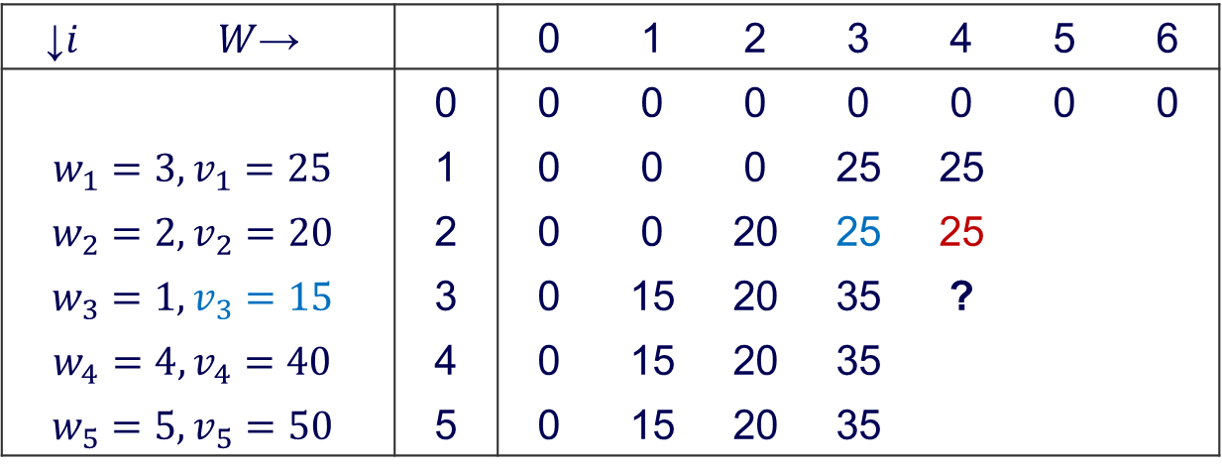
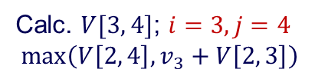
Bottom-Up DP algorithm
$$V\left[i,j\right]=\left\{\begin{aligned}\max\left(V\left[i−1,j\right],v_{i}+V\left[i−1,j−w_{i}\right]\right) if j−w_{i}≥0 \\ V\left[i−1,j\right] if j−w_{i}<0\end{aligned}\right.$$
$$V\left[0,j\right]=0 for i≥0 and V\left[i,0\right]=0 for i≥0$$
↓$i$ | $W$→ |  | 0 | 1 | 2 | 3 | 4 | 5 | 6
 |  | 0 | 0 | 0 | 0 | 0 | 0 | 0 | 0
$$w_{1}=3, v_{1}=25$$ |  | 1 | 0 | 0 | 0 | 25 | 25
$$w_{2}=2, v_{2}=20$$ |  | 2 | 0 | 0 | 20 | 25 | 25
$$w_{3}=1, v_{3}=15$$ |  | 3 | 0 | 15 | 20 | 35 | ?
$$w_{4}=4, v_{4}=40$$ |  | 4 | 0 | 15 | 20 | 35
$$w_{5}=5, v_{5}=50$$ |  | 5 | 0 | 15 | 20 | 35
Calc. $V[3, 4]$; $i=3, j=4$
$$\max\left(V\left[2, 4\right],v_{3}+V\left[2, 3\right]\right)$$

Slide 40
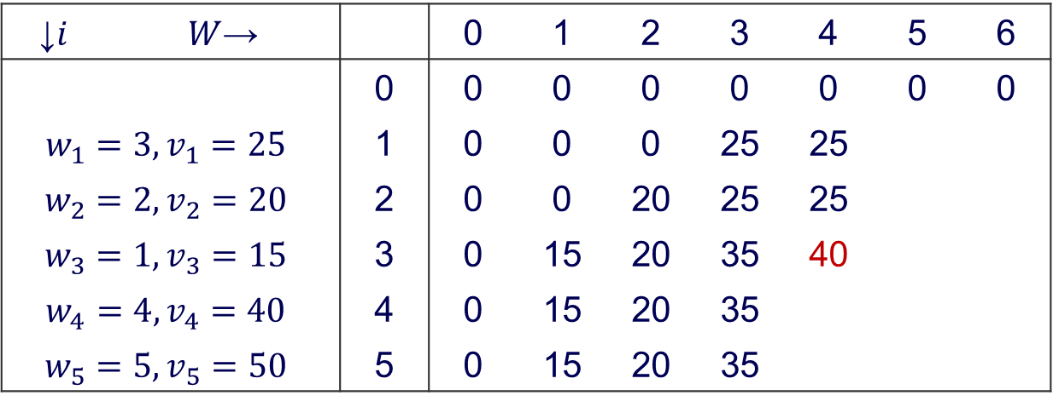
Bottom-Up DP algorithm
$$V\left[i,j\right]=\left\{\begin{aligned}\max\left(V\left[i−1,j\right],v_{i}+V\left[i−1,j−w_{i}\right]\right) if j−w_{i}≥0 \\ V\left[i−1,j\right] if j−w_{i}<0\end{aligned}\right.$$
$$V\left[0,j\right]=0 for i≥0 and V\left[i,0\right]=0 for i≥0$$
↓$i$ | $W$→ |  | 0 | 1 | 2 | 3 | 4 | 5 | 6
 |  | 0 | 0 | 0 | 0 | 0 | 0 | 0 | 0
$$w_{1}=3, v_{1}=25$$ |  | 1 | 0 | 0 | 0 | 25 | 25
$$w_{2}=2, v_{2}=20$$ |  | 2 | 0 | 0 | 20 | 25 | 25
$$w_{3}=1, v_{3}=15$$ |  | 3 | 0 | 15 | 20 | 35 | 40
$$w_{4}=4, v_{4}=40$$ |  | 4 | 0 | 15 | 20 | 35
$$w_{5}=5, v_{5}=50$$ |  | 5 | 0 | 15 | 20 | 35

Slide 41
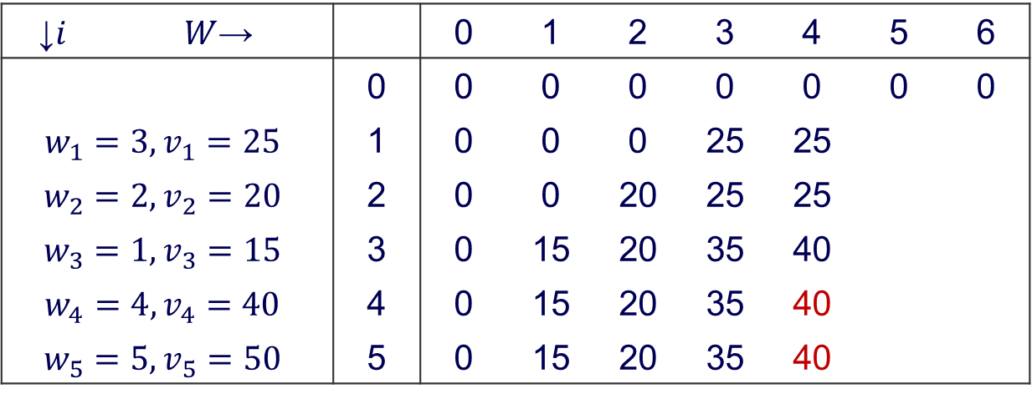
Bottom-Up DP algorithm
$$V\left[i,j\right]=\left\{\begin{aligned}\max\left(V\left[i−1,j\right],v_{i}+V\left[i−1,j−w_{i}\right]\right) if j−w_{i}≥0 \\ V\left[i−1,j\right] if j−w_{i}<0\end{aligned}\right.$$
$$V\left[0,j\right]=0 for i≥0 and V\left[i,0\right]=0 for i≥0$$
↓$i$ | $W$→ |  | 0 | 1 | 2 | 3 | 4 | 5 | 6
 |  | 0 | 0 | 0 | 0 | 0 | 0 | 0 | 0
$$w_{1}=3, v_{1}=25$$ |  | 1 | 0 | 0 | 0 | 25 | 25
$$w_{2}=2, v_{2}=20$$ |  | 2 | 0 | 0 | 20 | 25 | 25
$$w_{3}=1, v_{3}=15$$ |  | 3 | 0 | 15 | 20 | 35 | 40
$$w_{4}=4, v_{4}=40$$ |  | 4 | 0 | 15 | 20 | 35 | 40
$$w_{5}=5, v_{5}=50$$ |  | 5 | 0 | 15 | 20 | 35 | 40

Slide 42
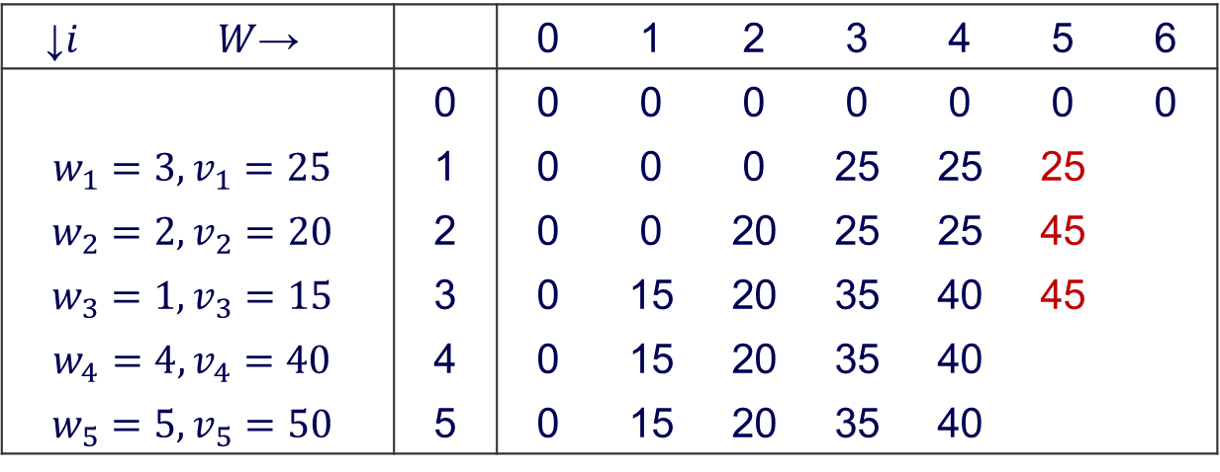
Bottom-Up DP algorithm
$$V\left[i,j\right]=\left\{\begin{aligned}\max\left(V\left[i−1,j\right],v_{i}+V\left[i−1,j−w_{i}\right]\right) if j−w_{i}≥0 \\ V\left[i−1,j\right] if j−w_{i}<0\end{aligned}\right.$$
$$V\left[0,j\right]=0 for i≥0 and V\left[i,0\right]=0 for i≥0$$
↓$i$ | $W$→ |  | 0 | 1 | 2 | 3 | 4 | 5 | 6
 |  | 0 | 0 | 0 | 0 | 0 | 0 | 0 | 0
$$w_{1}=3, v_{1}=25$$ |  | 1 | 0 | 0 | 0 | 25 | 25 | 25
$$w_{2}=2, v_{2}=20$$ |  | 2 | 0 | 0 | 20 | 25 | 25 | 45
$$w_{3}=1, v_{3}=15$$ |  | 3 | 0 | 15 | 20 | 35 | 40 | 45
$$w_{4}=4, v_{4}=40$$ |  | 4 | 0 | 15 | 20 | 35 | 40
$$w_{5}=5, v_{5}=50$$ |  | 5 | 0 | 15 | 20 | 35 | 40

Slide 43
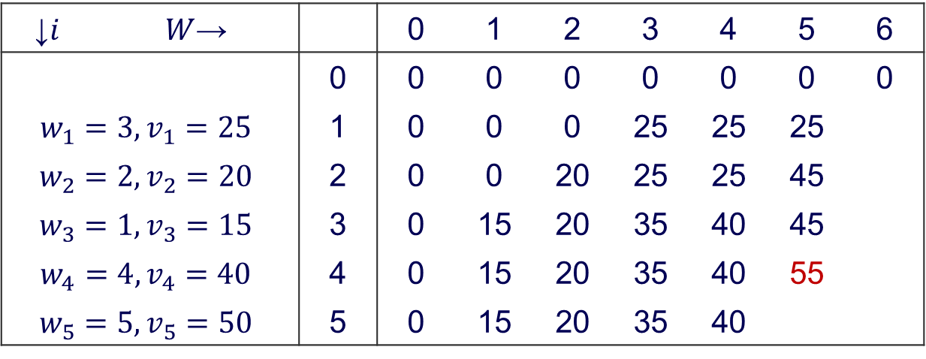
Bottom-Up DP algorithm
$$V\left[i,j\right]=\left\{\begin{aligned}\max\left(V\left[i−1,j\right],v_{i}+V\left[i−1,j−w_{i}\right]\right) if j−w_{i}≥0 \\ V\left[i−1,j\right] if j−w_{i}<0\end{aligned}\right.$$
$$V\left[0,j\right]=0 for i≥0 and V\left[i,0\right]=0 for i≥0$$
↓$i$ | $W$→ |  | 0 | 1 | 2 | 3 | 4 | 5 | 6
 |  | 0 | 0 | 0 | 0 | 0 | 0 | 0 | 0
$$w_{1}=3, v_{1}=25$$ |  | 1 | 0 | 0 | 0 | 25 | 25 | 25
$$w_{2}=2, v_{2}=20$$ |  | 2 | 0 | 0 | 20 | 25 | 25 | 45
$$w_{3}=1, v_{3}=15$$ |  | 3 | 0 | 15 | 20 | 35 | 40 | 45
$$w_{4}=4, v_{4}=40$$ |  | 4 | 0 | 15 | 20 | 35 | 40 | 55
$$w_{5}=5, v_{5}=50$$ |  | 5 | 0 | 15 | 20 | 35 | 40

Slide 44
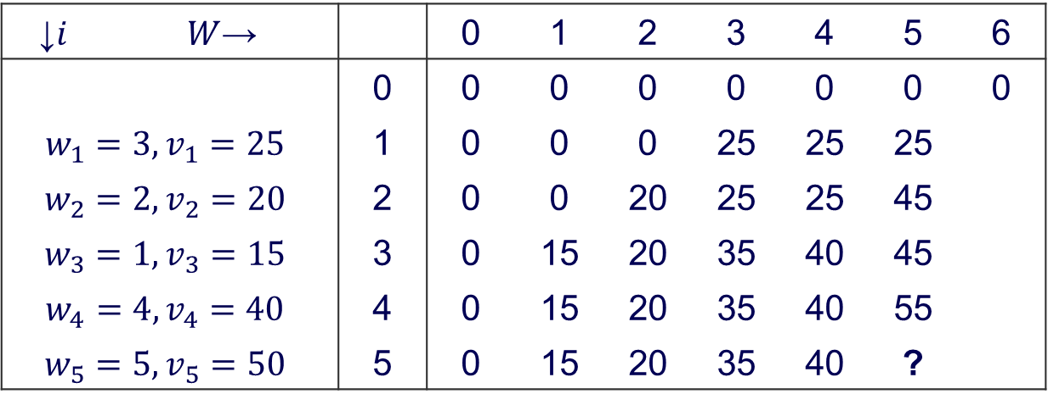
Bottom-Up DP algorithm
$$V\left[i,j\right]=\left\{\begin{aligned}\max\left(V\left[i−1,j\right],v_{i}+V\left[i−1,j−w_{i}\right]\right) if j−w_{i}≥0 \\ V\left[i−1,j\right] if j−w_{i}<0\end{aligned}\right.$$
$$V\left[0,j\right]=0 for i≥0 and V\left[i,0\right]=0 for i≥0$$
↓$i$ | $W$→ |  | 0 | 1 | 2 | 3 | 4 | 5 | 6
 |  | 0 | 0 | 0 | 0 | 0 | 0 | 0 | 0
$$w_{1}=3, v_{1}=25$$ |  | 1 | 0 | 0 | 0 | 25 | 25 | 25
$$w_{2}=2, v_{2}=20$$ |  | 2 | 0 | 0 | 20 | 25 | 25 | 45
$$w_{3}=1, v_{3}=15$$ |  | 3 | 0 | 15 | 20 | 35 | 40 | 45
$$w_{4}=4, v_{4}=40$$ |  | 4 | 0 | 15 | 20 | 35 | 40 | 55
$$w_{5}=5, v_{5}=50$$ |  | 5 | 0 | 15 | 20 | 35 | 40 | ?

Slide 45
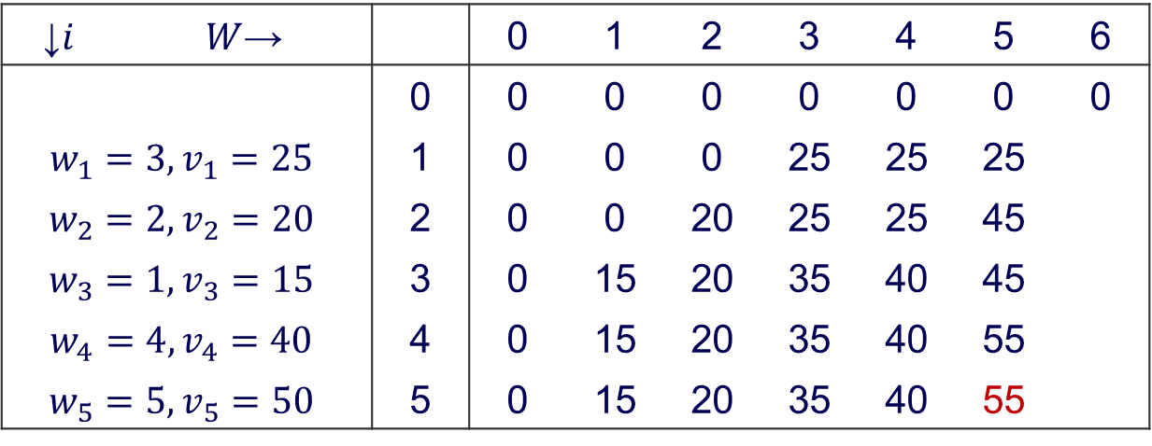
Bottom-Up DP algorithm
$$V\left[i,j\right]=\left\{\begin{aligned}\max\left(V\left[i−1,j\right],v_{i}+V\left[i−1,j−w_{i}\right]\right) if j−w_{i}≥0 \\ V\left[i−1,j\right] if j−w_{i}<0\end{aligned}\right.$$
$$V\left[0,j\right]=0 for i≥0 and V\left[i,0\right]=0 for i≥0$$
↓$i$ | $W$→ |  | 0 | 1 | 2 | 3 | 4 | 5 | 6
 |  | 0 | 0 | 0 | 0 | 0 | 0 | 0 | 0
$$w_{1}=3, v_{1}=25$$ |  | 1 | 0 | 0 | 0 | 25 | 25 | 25
$$w_{2}=2, v_{2}=20$$ |  | 2 | 0 | 0 | 20 | 25 | 25 | 45
$$w_{3}=1, v_{3}=15$$ |  | 3 | 0 | 15 | 20 | 35 | 40 | 45
$$w_{4}=4, v_{4}=40$$ |  | 4 | 0 | 15 | 20 | 35 | 40 | 55
$$w_{5}=5, v_{5}=50$$ |  | 5 | 0 | 15 | 20 | 35 | 40 | 55

Slide 46
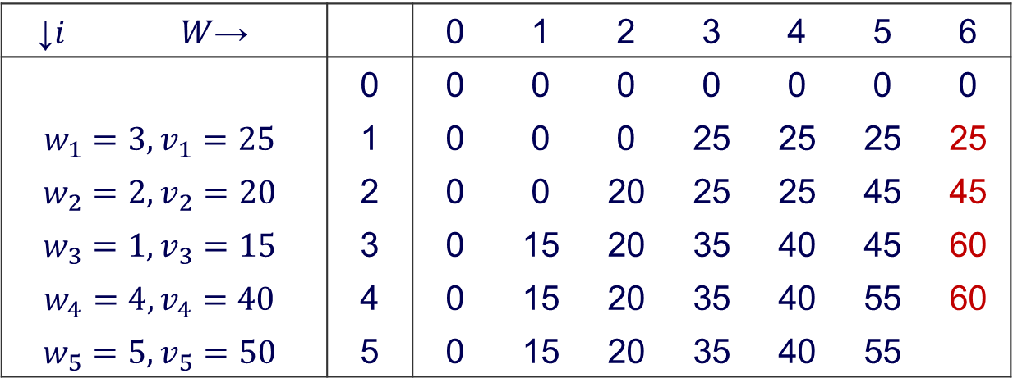
Bottom-Up DP algorithm
$$V\left[i,j\right]=\left\{\begin{aligned}\max\left(V\left[i−1,j\right],v_{i}+V\left[i−1,j−w_{i}\right]\right) if j−w_{i}≥0 \\ V\left[i−1,j\right] if j−w_{i}<0\end{aligned}\right.$$
$$V\left[0,j\right]=0 for i≥0 and V\left[i,0\right]=0 for i≥0$$
↓$i$ | $W$→ |  | 0 | 1 | 2 | 3 | 4 | 5 | 6
 |  | 0 | 0 | 0 | 0 | 0 | 0 | 0 | 0
$$w_{1}=3, v_{1}=25$$ |  | 1 | 0 | 0 | 0 | 25 | 25 | 25 | 25
$$w_{2}=2, v_{2}=20$$ |  | 2 | 0 | 0 | 20 | 25 | 25 | 45 | 45
$$w_{3}=1, v_{3}=15$$ |  | 3 | 0 | 15 | 20 | 35 | 40 | 45 | 60
$$w_{4}=4, v_{4}=40$$ |  | 4 | 0 | 15 | 20 | 35 | 40 | 55 | 60
$$w_{5}=5, v_{5}=50$$ |  | 5 | 0 | 15 | 20 | 35 | 40 | 55

Slide 47
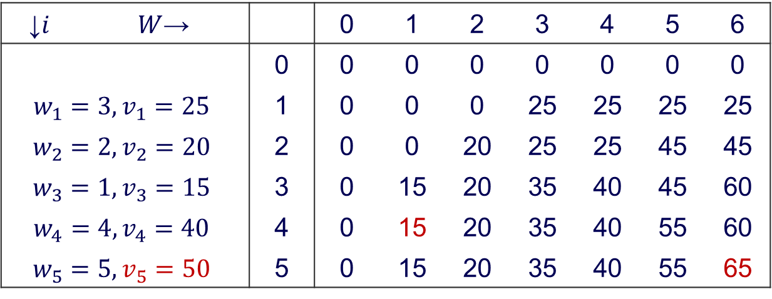
Bottom-Up DP algorithm
$$V\left[i,j\right]=\left\{\begin{aligned}\max\left(V\left[i−1,j\right],v_{i}+V\left[i−1,j−w_{i}\right]\right) if j−w_{i}≥0 \\ V\left[i−1,j\right] if j−w_{i}<0\end{aligned}\right.$$
$$V\left[0,j\right]=0 for i≥0 and V\left[i,0\right]=0 for i≥0$$
↓$i$ | $W$→ |  | 0 | 1 | 2 | 3 | 4 | 5 | 6
 |  | 0 | 0 | 0 | 0 | 0 | 0 | 0 | 0
$$w_{1}=3, v_{1}=25$$ |  | 1 | 0 | 0 | 0 | 25 | 25 | 25 | 25
$$w_{2}=2, v_{2}=20$$ |  | 2 | 0 | 0 | 20 | 25 | 25 | 45 | 45
$$w_{3}=1, v_{3}=15$$ |  | 3 | 0 | 15 | 20 | 35 | 40 | 45 | 60
$$w_{4}=4, v_{4}=40$$ |  | 4 | 0 | 15 | 20 | 35 | 40 | 55 | 60
$$w_{5}=5, v_{5}=50$$ |  | 5 | 0 | 15 | 20 | 35 | 40 | 55 | 65

Slide 48
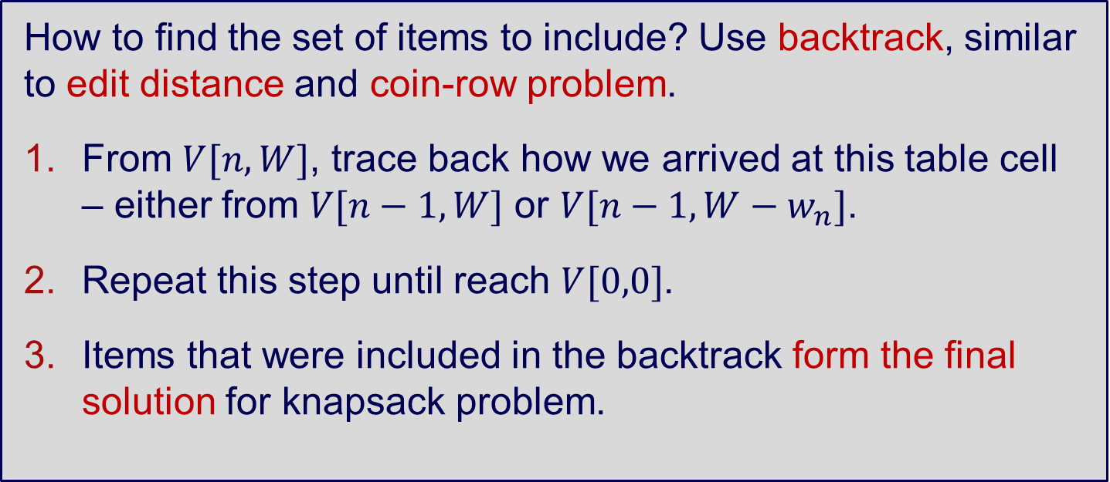
Bottom-Up DP algorithm – Backtrack
How to find the set of items to include? Use backtrack, similar to edit distance and coin-row problem.
From $V[n,W]$, trace back how we arrived at this table cell – either from $V[n−1,W]$ or $V[n−1,W−w_{n}]$.
Repeat this step until reach $V[0,0]$.
Items that were included in the backtrack form the final solution for knapsack problem.

Slide 49
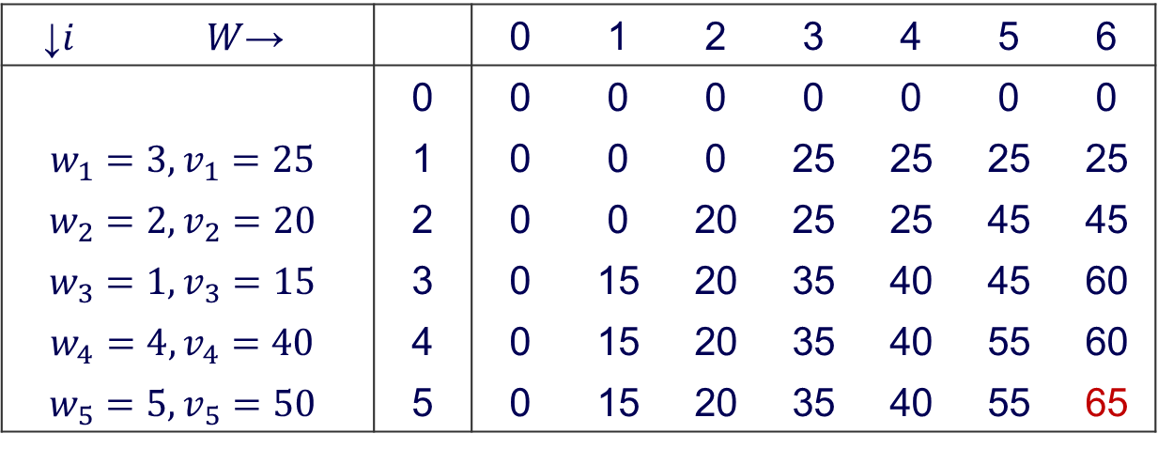
Bottom-Up DP algorithm – Backtrace
↓$i$ | $W$→ |  | 0 | 1 | 2 | 3 | 4 | 5 | 6
 |  | 0 | 0 | 0 | 0 | 0 | 0 | 0 | 0
$$w_{1}=3, v_{1}=25$$ |  | 1 | 0 | 0 | 0 | 25 | 25 | 25 | 25
$$w_{2}=2, v_{2}=20$$ |  | 2 | 0 | 0 | 20 | 25 | 25 | 45 | 45
$$w_{3}=1, v_{3}=15$$ |  | 3 | 0 | 15 | 20 | 35 | 40 | 45 | 60
$$w_{4}=4, v_{4}=40$$ |  | 4 | 0 | 15 | 20 | 35 | 40 | 55 | 60
$$w_{5}=5, v_{5}=50$$ |  | 5 | 0 | 15 | 20 | 35 | 40 | 55 | 65
Let’s do the backtrack!

Slide 50
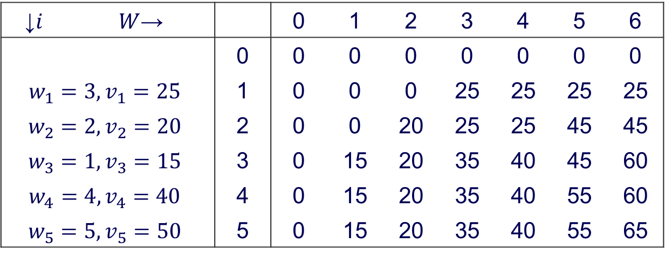
Bottom-Up DP algorithm – Backtrace
↓$i$ | $W$→ |  | 0 | 1 | 2 | 3 | 4 | 5 | 6
 |  | 0 | 0 | 0 | 0 | 0 | 0 | 0 | 0
$$w_{1}=3, v_{1}=25$$ |  | 1 | 0 | 0 | 0 | 25 | 25 | 25 | 25
$$w_{2}=2, v_{2}=20$$ |  | 2 | 0 | 0 | 20 | 25 | 25 | 45 | 45
$$w_{3}=1, v_{3}=15$$ |  | 3 | 0 | 15 | 20 | 35 | 40 | 45 | 60
$$w_{4}=4, v_{4}=40$$ |  | 4 | 0 | 15 | 20 | 35 | 40 | 55 | 60
$$w_{5}=5, v_{5}=50$$ |  | 5 | 0 | 15 | 20 | 35 | 40 | 55 | 65
5th
Notes:
Here we consider whether we should include item 5th or not, because there is a difference V[5,6] != V[4,6] → item 5th is in the knapsack
We then move to the position V[i – 1, j – wi], which allows taking the 5th item = V[5 – 1, 6 – 5] = V[4,1]
We do the same comparison V[4,1] = V[3,1] → item 4th is not in the knapsack

Slide 51
Bottom-Up DP algorithm – Backtrace
↓$i$ | $W$→ |  | 0 | 1 | 2 | 3 | 4 | 5 | 6
 |  | 0 | 0 | 0 | 0 | 0 | 0 | 0 | 0
$$w_{1}=3, v_{1}=25$$ |  | 1 | 0 | 0 | 0 | 25 | 25 | 25 | 25
$$w_{2}=2, v_{2}=20$$ |  | 2 | 0 | 0 | 20 | 25 | 25 | 45 | 45
$$w_{3}=1, v_{3}=15$$ |  | 3 | 0 | 15 | 20 | 35 | 40 | 45 | 60
$$w_{4}=4, v_{4}=40$$ |  | 4 | 0 | 15 | 20 | 35 | 40 | 55 | 60
$$w_{5}=5, v_{5}=50$$ |  | 5 | 0 | 15 | 20 | 35 | 40 | 55 | 65
3rd
5th
Notes:
V[5,6] != V[4,6] → item 5th is in the knapsack
Move to V[i – 1, j – wi] = V[5 – 1, 6 – 5] = V[4,1]
V[4,1] = V[3,1] → item 4th is not in the knapsack
V[3,1] != V[2,1] → item 3rd is in the knapsack
Move to V[i – 1, j – wi] = V[3 – 1, 1 – 1] = V[2,0]

Slide 52
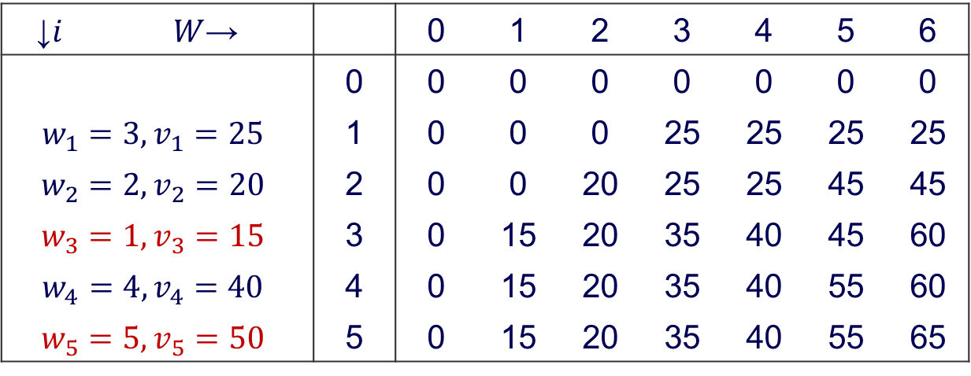
Bottom-Up DP algorithm – Backtrace
↓$i$ | $W$→ |  | 0 | 1 | 2 | 3 | 4 | 5 | 6
 |  | 0 | 0 | 0 | 0 | 0 | 0 | 0 | 0
$$w_{1}=3, v_{1}=25$$ |  | 1 | 0 | 0 | 0 | 25 | 25 | 25 | 25
$$w_{2}=2, v_{2}=20$$ |  | 2 | 0 | 0 | 20 | 25 | 25 | 45 | 45
$$w_{3}=1, v_{3}=15$$ |  | 3 | 0 | 15 | 20 | 35 | 40 | 45 | 60
$$w_{4}=4, v_{4}=40$$ |  | 4 | 0 | 15 | 20 | 35 | 40 | 55 | 60
$$w_{5}=5, v_{5}=50$$ |  | 5 | 0 | 15 | 20 | 35 | 40 | 55 | 65
3rd
5th
Notes:
V[5,6] != V[4,6] → item 5th is in the knapsack
Move to V[i – 1, j – wi] = V[5 – 1, 6 – 5] = V[4,1]
V[4,1] = V[3,1] → item 4th is not in the knapsack
V[3,1] != V[2,1] → item 3rd is in the knapsack
Move to V[i – 1, j – wi] = V[3 – 1, 1 – 1] = V[2,0]

Slide 53
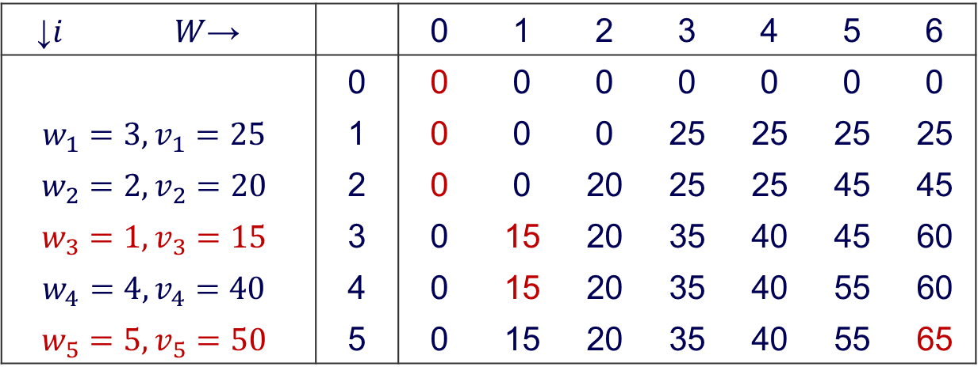
Bottom-Up DP algorithm – Backtrace
↓$i$ | $W$→ |  | 0 | 1 | 2 | 3 | 4 | 5 | 6
 |  | 0 | 0 | 0 | 0 | 0 | 0 | 0 | 0
$$w_{1}=3, v_{1}=25$$ |  | 1 | 0 | 0 | 0 | 25 | 25 | 25 | 25
$$w_{2}=2, v_{2}=20$$ |  | 2 | 0 | 0 | 20 | 25 | 25 | 45 | 45
$$w_{3}=1, v_{3}=15$$ |  | 3 | 0 | 15 | 20 | 35 | 40 | 45 | 60
$$w_{4}=4, v_{4}=40$$ |  | 4 | 0 | 15 | 20 | 35 | 40 | 55 | 60
$$w_{5}=5, v_{5}=50$$ |  | 5 | 0 | 15 | 20 | 35 | 40 | 55 | 65
Question: In general, using the dynamic programming table, how can we tell if there are multiple optimal solutions to a Knapsack problem?

Slide 54
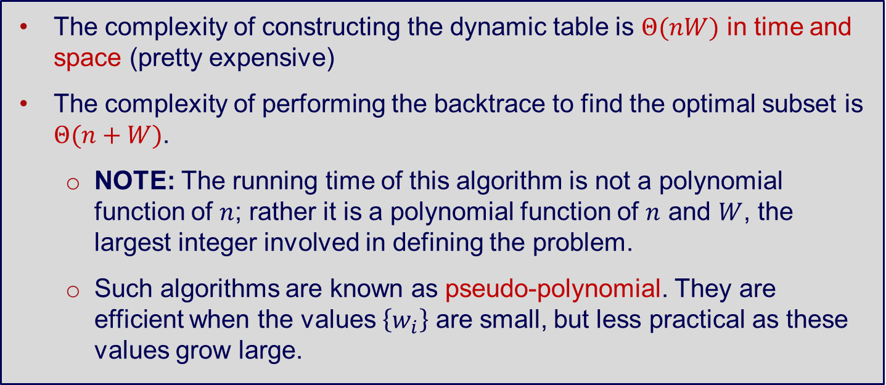
DP Knapsack Problem
The complexity of constructing the dynamic table is $Θ(nW)$ in time and space (pretty expensive)
The complexity of performing the backtrace to find the optimal subset is $Θ(n+W)$.
NOTE: The running time of this algorithm is not a polynomial function of $n$; rather it is a polynomial function of $n$ and $W$, the largest integer involved in defining the problem.
Such algorithms are known as pseudo-polynomial. They are efficient when the values $\left\{w_{i}\right\}$ are small, but less practical as these values grow large.

Slide 55
1b. Knapsack Problem (Top Down)
Notes:
To create Em dash above headline:
Same size and weight as the headline and set using a soft return.
PC: Em dash (—): Alt+Ctrl+ - (minus)
Mac: Em dash (—): Shift+Alt/Option+hyphen

Slide 56
DP Knapsack Problem – Top-Down
“Divide and conquer” type of (top down) approach of solving knapsack generally recompute many previously computed sub-problems, hence inefficient.
Bottom up dynamic programming approach avoids re-computation, but can compute many unnecessary solutions to sub-problems.
Combine space saving of “divide and conquer” and speed up of bottom up approaches?

Slide 57
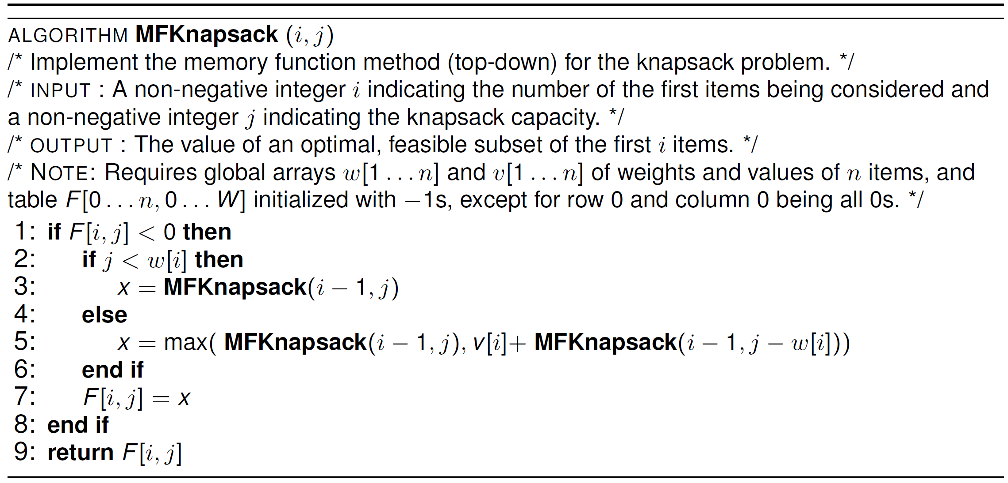
DP Knapsack Problem – Top-Down

Slide 58
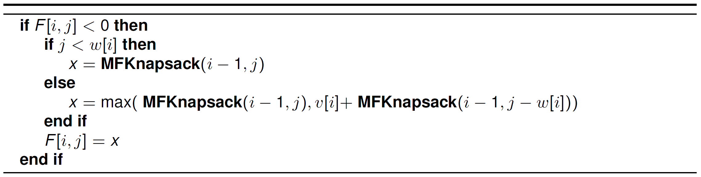
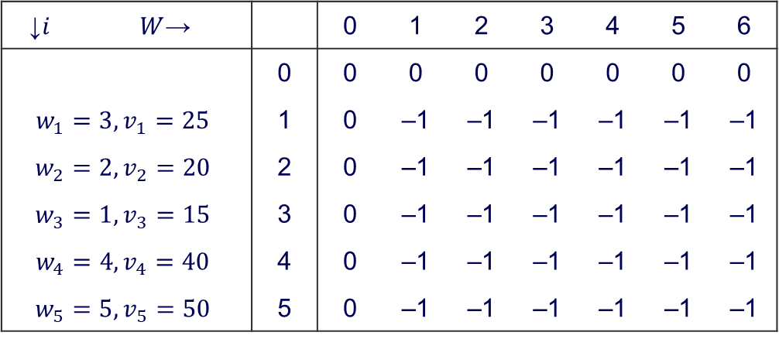
DP Knapsack Problem – Top-Down
↓$i$ | $W$→ |  | 0 | 1 | 2 | 3 | 4 | 5 | 6
 |  | 0 | 0 | 0 | 0 | 0 | 0 | 0 | 0
$$w_{1}=3, v_{1}=25$$ |  | 1 | 0 | –1 | –1 | –1 | –1 | –1 | –1
$$w_{2}=2, v_{2}=20$$ |  | 2 | 0 | –1 | –1 | –1 | –1 | –1 | –1
$$w_{3}=1, v_{3}=15$$ |  | 3 | 0 | –1 | –1 | –1 | –1 | –1 | –1
$$w_{4}=4, v_{4}=40$$ |  | 4 | 0 | –1 | –1 | –1 | –1 | –1 | –1
$$w_{5}=5, v_{5}=50$$ |  | 5 | 0 | –1 | –1 | –1 | –1 | –1 | –1
Initially, set all values to -1 to indicate that the entries are not yet calculated
When a new value needs to be calculated, the method checks the table

Slide 59
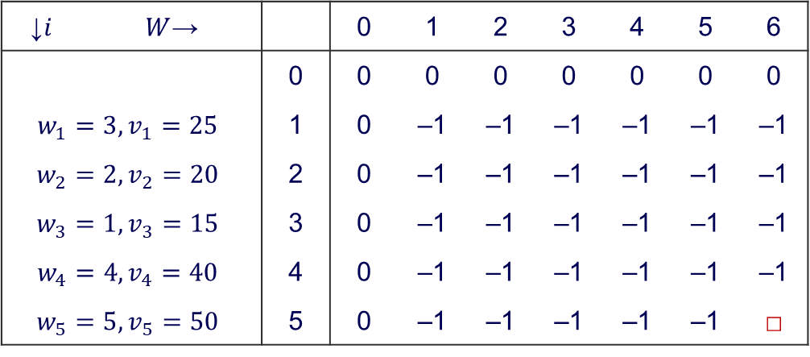
DP Knapsack Problem – Top-Down
↓$i$ | $W$→ |  | 0 | 1 | 2 | 3 | 4 | 5 | 6
 |  | 0 | 0 | 0 | 0 | 0 | 0 | 0 | 0
$$w_{1}=3, v_{1}=25$$ |  | 1 | 0 | –1 | –1 | –1 | –1 | –1 | –1
$$w_{2}=2, v_{2}=20$$ |  | 2 | 0 | –1 | –1 | –1 | –1 | –1 | –1
$$w_{3}=1, v_{3}=15$$ |  | 3 | 0 | –1 | –1 | –1 | –1 | –1 | –1
$$w_{4}=4, v_{4}=40$$ |  | 4 | 0 | –1 | –1 | –1 | –1 | –1 | –1
$$w_{5}=5, v_{5}=50$$ |  | 5 | 0 | –1 | –1 | –1 | –1 | –1 | □
Let’s start with M(5,6)

Slide 60
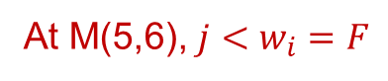
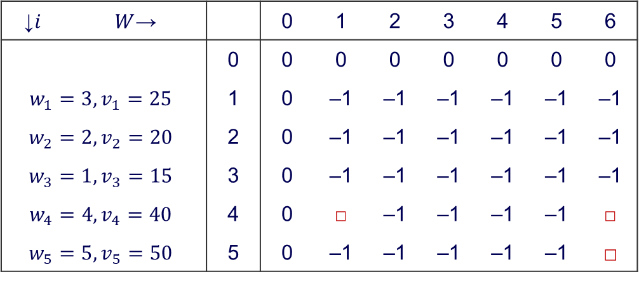
DP Knapsack Problem – Top-Down
↓$i$ | $W$→ |  | 0 | 1 | 2 | 3 | 4 | 5 | 6
 |  | 0 | 0 | 0 | 0 | 0 | 0 | 0 | 0
$$w_{1}=3, v_{1}=25$$ |  | 1 | 0 | –1 | –1 | –1 | –1 | –1 | –1
$$w_{2}=2, v_{2}=20$$ |  | 2 | 0 | –1 | –1 | –1 | –1 | –1 | –1
$$w_{3}=1, v_{3}=15$$ |  | 3 | 0 | –1 | –1 | –1 | –1 | –1 | –1
$$w_{4}=4, v_{4}=40$$ |  | 4 | 0 | □ | –1 | –1 | –1 | –1 | □
$$w_{5}=5, v_{5}=50$$ |  | 5 | 0 | –1 | –1 | –1 | –1 | –1 | □
At M(5,6), $j<w_{i}=F$
We calculate M(4,6) and M(4,1)
Notes:
We check whether j < wi. Here j = 6, w5 = 5; 6 > 5, so max[M(5-1,6), v5 + M(5-1, 6-w5)] = max[M(4,6), 5 + M(4,1)]

Slide 61
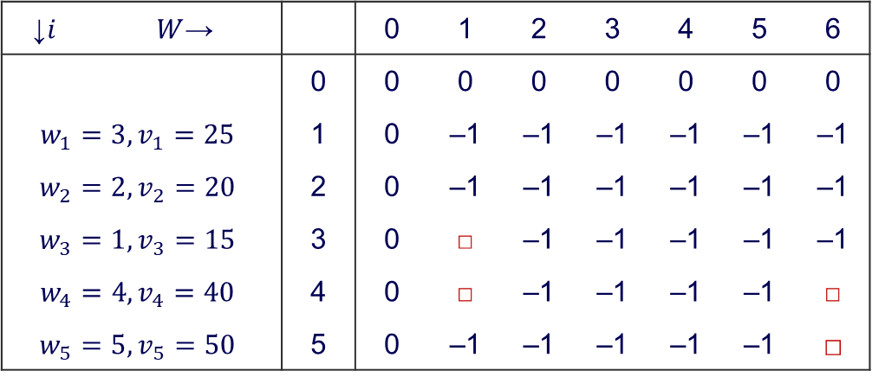
DP Knapsack Problem – Top-Down
↓$i$ | $W$→ |  | 0 | 1 | 2 | 3 | 4 | 5 | 6
 |  | 0 | 0 | 0 | 0 | 0 | 0 | 0 | 0
$$w_{1}=3, v_{1}=25$$ |  | 1 | 0 | –1 | –1 | –1 | –1 | –1 | –1
$$w_{2}=2, v_{2}=20$$ |  | 2 | 0 | –1 | –1 | –1 | –1 | –1 | –1
$$w_{3}=1, v_{3}=15$$ |  | 3 | 0 | □ | –1 | –1 | –1 | –1 | –1
$$w_{4}=4, v_{4}=40$$ |  | 4 | 0 | □ | –1 | –1 | –1 | –1 | □
$$w_{5}=5, v_{5}=50$$ |  | 5 | 0 | –1 | –1 | –1 | –1 | –1 | □
M(4,1)
→ Calculate M(3,1)

Slide 62

DP Knapsack Problem – Top-Down
↓$i$ | $W$→ |  | 0 | 1 | 2 | 3 | 4 | 5 | 6
 |  | 0 | 0 | 0 | 0 | 0 | 0 | 0 | 0
$$w_{1}=3, v_{1}=25$$ |  | 1 | 0 | □ | –1 | –1 | –1 | –1 | –1
$$w_{2}=2, v_{2}=20$$ |  | 2 | 0 | □ | –1 | –1 | –1 | –1 | –1
$$w_{3}=1, v_{3}=15$$ |  | 3 | 0 | □ | –1 | –1 | –1 | –1 | –1
$$w_{4}=4, v_{4}=40$$ |  | 4 | 0 | □ | –1 | –1 | –1 | –1 | □
$$w_{5}=5, v_{5}=50$$ |  | 5 | 0 | –1 | –1 | –1 | –1 | –1 | □

Slide 63

DP Knapsack Problem – Top-Down
↓$i$ | $W$→ |  | 0 | 1 | 2 | 3 | 4 | 5 | 6
 |  | 0 | 0 | 0 | 0 | 0 | 0 | 0 | 0
$$w_{1}=3, v_{1}=25$$ |  | 1 | 0 | □ | –1 | –1 | –1 | –1 | –1
$$w_{2}=2, v_{2}=20$$ |  | 2 | 0 | □ | –1 | –1 | –1 | –1 | –1
$$w_{3}=1, v_{3}=15$$ |  | 3 | 0 | □ | □ | –1 | –1 | –1 | □
$$w_{4}=4, v_{4}=40$$ |  | 4 | 0 | □ | –1 | –1 | –1 | –1 | □
$$w_{5}=5, v_{5}=50$$ |  | 5 | 0 | –1 | –1 | –1 | –1 | –1 | □
M(4,6) → M(3,6), M(3,2)

Slide 64

DP Knapsack Problem – Top-Down
↓$i$ | $W$→ |  | 0 | 1 | 2 | 3 | 4 | 5 | 6
 |  | 0 | 0 | 0 | 0 | 0 | 0 | 0 | 0
$$w_{1}=3, v_{1}=25$$ |  | 1 | 0 | □ | □ | □ | □ | □ | □
$$w_{2}=2, v_{2}=20$$ |  | 2 | 0 | □ | □ | –1 | –1 | □ | □
$$w_{3}=1, v_{3}=15$$ |  | 3 | 0 | □ | □ | –1 | –1 | –1 | □
$$w_{4}=4, v_{4}=40$$ |  | 4 | 0 | □ | –1 | –1 | –1 | –1 | □
$$w_{5}=5, v_{5}=50$$ |  | 5 | 0 | –1 | –1 | –1 | –1 | –1 | □

Slide 65

DP Knapsack Problem – Top-Down
↓$i$ | $W$→ |  | 0 | 1 | 2 | 3 | 4 | 5 | 6
 |  | 0 | 0 | 0 | 0 | 0 | 0 | 0 | 0
$$w_{1}=3, v_{1}=25$$ |  | 1 | 0 | □ | □ | □ | □ | □ | □
$$w_{2}=2, v_{2}=20$$ |  | 2 | 0 | □ | □ | – | – | □ | □
$$w_{3}=1, v_{3}=15$$ |  | 3 | 0 | □ | □ | – | – | – | □
$$w_{4}=4, v_{4}=40$$ |  | 4 | 0 | □ | – | – | – | – | □
$$w_{5}=5, v_{5}=50$$ |  | 5 | 0 | – | – | – | – | – | □
Red squares indicate the possible items that we need to calculate
Notes:
Red squares indicate the possible items that we need to calculate

Slide 66

DP Knapsack Problem – Top-Down
↓$i$ | $W$→ |  | 0 | 1 | 2 | 3 | 4 | 5 | 6
 |  | 0 | 0 | 0 | 0 | 0 | 0 | 0 | 0
$$w_{1}=3, v_{1}=25$$ |  | 1 | 0 | 0 | 0 | 25 | 25 | 25 | 25
$$w_{2}=2, v_{2}=20$$ |  | 2 | 0 | 0 | 20 | – | – | 45 | 45
$$w_{3}=1, v_{3}=15$$ |  | 3 | 0 | 15 | 20 | – | – | – | 60
$$w_{4}=4, v_{4}=40$$ |  | 4 | 0 | 15 | – | – | – | – | 60
$$w_{5}=5, v_{5}=50$$ |  | 5 | 0 | – | – | – | – | – | 65
No need to calculate every entry as done in the Bottom-Up approach
This approach also enables retrieving values rather than recomputing

Slide 67
Top-Down vs. Bottom-Up
In general, when to use top-down or bottom-up dynamic programming?
Top-down incurs additional space and time cost of maintaining stack space for storing recursive function calls. Hence:
Bottom-up: When the final problem instance requires most or all of the sub-problem instances to be solved, e.g., edit distance.
Top-down: When the final problem instance only requires a subset of the sub-problem instances to be solved, e.g., possibly knapsack.

Slide 68
2. Greedy Approach
Notes:
To create Em dash above headline:
Same size and weight as the headline and set using a soft return.
PC: Em dash (—): Alt+Ctrl+ - (minus)
Mac: Em dash (—): Shift+Alt/Option+hyphen

Slide 69
Greedy Algorithms
Greedy Algorithms build up a solution piece by piece, always choosing the next piece that offers the most immediate and obvious benefit.
Sometimes such an approach can be lead to an inferior solution, but in other cases it can lead to a simple and optimal solution.

Slide 70
2a. Prim’s Algorithm
Notes:
To create Em dash above headline:
Same size and weight as the headline and set using a soft return.
PC: Em dash (—): Alt+Ctrl+ - (minus)
Mac: Em dash (—): Shift+Alt/Option+hyphen

Slide 71
Spanning Tree Problem
A spanning tree of a connected graph is a connected acyclic subgraph (i.e., a tree) which contains
all the vertices of the graph, and
a subset of edges from the original graph.

Slide 72




Minimum Spanning Tree Problem
A minimum spanning tree of a weighted connected graph is the spanning tree of the smallest total weight (sum of the weights on all of the tree’s edges).

Slide 73
Applications of Minimum Spanning Tree
Designing networks (phones, computers etc.): Want to connect up a series of offices with telephone or wired lines, but want to minimise cost.
Approximate solutions to hard problems: travelling salesman
“Given a list of cities and the distances between each pair of cities, what is the shortest possible route that visits each city exactly once and returns to the origin city"

Slide 74
Prim’s Algorithm – Sketch
Prim’s Algorithm is one approach to find minimum spanning tree.
Idea: Select one vertex at a time and add to tree.
Start with one randomly selected vertex and add this to tree.
Then at each iteration, add a neighbouring vertex to the tree that has minimum edge weight to one of the vertices in the current tree. It must not be in the tree.
Use a min priority queue to quickly find this neighbouring vertex with minimum edge weight (in literature, the neighbour set is sometimes called the frontier set).

Slide 75
Prim’s Algorithm – Sketch
When adding, we may need to update the smallest edge weight to a vertex in neighbour set, as there may be a smallest edge weight from updated tree to new neighbour set.
When all vertices added to tree, we are done.
Notes:
If there are multiple minimum edge weights then choose randomly

Slide 76

Prim’s Algorithm – Example

Slide 77

Prim’s Algorithm – Example

Slide 78

Prim’s Algorithm – Example

Slide 79

Prim’s Algorithm – Example

Slide 80

Prim’s Algorithm – Example

Slide 81

Prim’s Algorithm – Example

Slide 82
Prim’s Algorithm – Demo
https://www.cs.usfca.edu/~galles/visualization/Prim.html

Slide 83

Prim’s Algorithm – Summary
The algorithm always gives the optimal solution, regardless of where you start. Proof: http://www.oxfordmathcenter.com/drupal7/node/685
The efficiency of the algorithm using a min-heap and an adjacency list is $Θ(|E|\log{|V|)}$.
The efficiency of the algorithm using a Fibonacci heap and an adjacency list is $Θ(\left|E\right|+|V|\log{|V|)}$.
Notes:
logV is for the extraction of value from min heap (priority queue) and then repair/heaptify the min heap
https://www.geeksforgeeks.org/binary-heap/

Slide 84
2b. Dijkstra’s Algorithm

Slide 85

Shortest Paths in Graphs
Problem: Given a weighted connected graph, the shortest-path problem asks to find the shortest path from a starting source vertex to a destination target vertex.

Slide 86
Dijkstra’s Algorithm
Problem: Given a weighted connected graph, the single-source shortest-paths problem asks to find the shortest path to all vertices given a single starting source vertex.

Slide 87

Dijkstra’s Algorithm
Idea:
At all times, we maintain our best estimate of the shortest-path distances from source vertex to all other vertices.
Initially we don’t know, so all distance estimates are $∞$.
But as the algorithm explores the graph, we update our estimates, which converges to the true shortest path distance.

Slide 88

Dijkstra’s Algorithm – Sketch
Maintain a set $S$ of vertices whose final shortest-path weights from the source $s$ have already been determined.
Initially $S$ is empty. Initialise distance estimates to $∞$ for all non-source vertices. Distance of source vertex is 0.
Select the vertex $v$ not in $S$ with the minimum shortest-path estimate.
Add $v$ to $S$.
Update our distance estimates to neighbouring vertices that are not in $S$.
Repeat from step 2, until all vertices have been added to $S$.
Notes:
Similar to Prim’s algorithm, difference here is that we update the total distance from the source to the neighbours

Slide 89

Dijkstra’s Algorithm – Example

Slide 90

Dijkstra’s Algorithm – Example
Notes:
Start with a, now consider vertices that are not in S and are neighbours of a, which are b and d
Pick the smallest distance one, which is b (next two slides)

Slide 91

Dijkstra’s Algorithm – Example

Slide 92

Dijkstra’s Algorithm – Example
Notes:
Now we have a and d in the set S, consider vertices that are not in S and are neighbours to a and b, which are c and d
Update the total distance of c and d
Since we started from a and have decided a to b is the shortest route, we ignore a and consider from b
From b, we can go to c or d
C: abc(3+4)=7
D: abd(3+2)=5
Choose abd (next 2 slides)

Slide 93

Dijkstra’s Algorithm – Example

Slide 94

Dijkstra’s Algorithm – Example
Notes:
Now we have the shortest distances from a to b, and from b to d
We can consider a to b to c (3 + 4 = 7)
Or a to b to d to c (3 + 2 +5 = 10)
Or a to b to d to e (3 + 2 + 4 = 9)
Or a to d to e (7 + 4 = 11)

Slide 95

Dijkstra’s Algorithm – Example

Slide 96

Dijkstra’s Algorithm – Example

Slide 97






Dijkstra’s Algorithm – Example
So, we have the following distances from vertex $a$:
Which gives the following shortest paths:
$$a(a,0)$$
$$b(a,3)$$
$$d(b,5)$$
$$c(b,7)$$
$$e(d,9)$$
Length | Path
3 | a – b
5 | a – b – d
7 | a – b – c
9 | a – b – d – e

Slide 98

Dijkstra’s Algorithm – Summary
Dijkstra’s algorithm is guaranteed to always return the optimal solution.
This is not necessarily true for all greedy algorithms.
If we use an adjacency list and a min-heap, the algorithm runs in $Θ(|E|\log{|V|})$ time.
Notes:
logV is still for constructing the min heap

Slide 99

A* search
Extension of Dijkstra’s algorithm
https://www.youtube.com/watch?v=ySN5Wnu88nE

Slide 100
3. Stable Matching Problem
Notes:
To create Em dash above headline:
Same size and weight as the headline and set using a soft return.
PC: Em dash (—): Alt+Ctrl+ - (minus)
Mac: Em dash (—): Shift+Alt/Option+hyphen

Slide 101


Stable Marriage Problem

Slide 102

Stable Marriage Problem
Given a set of $n$ men and $n$ women, who has a list of preferences to the other sex (in terms of a ranking), the problem is how to find a matching between them such that the matching is stable?

Slide 103
Stable Marriage Problem
A matching is stable if:
No matched pair of man and woman can find other partners and both do better, i.e., both man and woman prefer other partners over their existing match.
Is a stable marriage (matching) always possible?
Yes, if equal number of men and women.

Slide 104
Gale-Shapley Algorithm
Idea: Female proposing variant:
Over a number of rounds, each unmatched female proposes to their remaining highest male preferences.
Each round, males reply “yes” to proposal from their highest female proposer and “no” to all other proposers.
This continues until all females (and males) are matched.

Slide 105
Gale-Shapley Algorithm
Female Proposing variant:
Round 1: Each female proposes to their first male preferences.
Each male receives 0 or more proposals. They reply “maybe” to the female they most prefer and “no” to all other proposals.
For each “maybe” reply, the corresponding female-male are tentatively matched.

Slide 106
Gale-Shapley Algorithm
Round 2: Each unmatched female proposes to their next preferred male (2nd ranked), even if the male is tentatively matched already.
Each male evaluates their proposals, and again reply “maybe” to the female they most prefer (this can be their existing matched partner) and “no” to all other proposals.
For each “maybe” reply, the corresponding female-male are tentatively matched.

Slide 107
Gale-Shapley Algorithm
Round 3 onwards: We continue with this process until all females and males are matched.

Slide 108

Gale-Shapley Algorithm – Example

Slide 109
Gale-Shapley Algorithm – Example
Anita | Sarah | Barbie | Michelle
Chris | Chris | Ken | Chris
Ken | Ken | Danny | Ken
Danny | Danny | John | Danny
John | John | Chris | John
Female preferences
Danny | Chris | John | Ken
Michelle | Anita | Barbie | Michelle
Sarah | Sarah | Anita | Barbie
Barbie | Michelle | Michelle | Sarah
Anita | Barbie | Sarah | Anita
Male preferences

Slide 110
Gale-Shapley Algorithm – Example
Anita | Sarah | Barbie | Michelle
Chris | Chris | Ken | Chris
Round 1
(proposing)
Danny | Chris | John | Ken
Michelle | Anita | Barbie | Michelle
Sarah | Sarah | Anita | Barbie
Barbie | Michelle | Michelle | Sarah
Anita | Barbie | Sarah | Anita

Slide 111
Gale-Shapley Algorithm – Example
Anita | Sarah | Barbie | Michelle
Chris | Chris | Ken | Chris
Round 1
(end)
Danny | Chris | John | Ken
Michelle | Anita | Barbie | Michelle
Sarah | Sarah | Anita | Barbie
Barbie | Michelle | Michelle | Sarah
Anita | Barbie | Sarah | Anita

Slide 112
Gale-Shapley Algorithm – Example
Anita | Sarah | Barbie | Michelle
Chris | Chris | Ken | Chris
 | Ken |  | Ken
Round 2
(proposing)
Danny | Chris | John | Ken
Michelle | Anita | Barbie | Michelle
Sarah | Sarah | Anita | Barbie
Barbie | Michelle | Michelle | Sarah
Anita | Barbie | Sarah | Anita

Slide 113
Gale-Shapley Algorithm – Example
Anita | Sarah | Barbie | Michelle
Chris | Chris | Ken | Chris
 | Ken |  | Ken
Round 2
(end)
Danny | Chris | John | Ken
Michelle | Anita | Barbie | Michelle
Sarah | Sarah | Anita | Barbie
Barbie | Michelle | Michelle | Sarah
Anita | Barbie | Sarah | Anita

Slide 114
Gale-Shapley Algorithm – Example
Anita | Sarah | Barbie | Michelle
Chris | Chris | Ken | Chris
 | Ken | Danny | Ken
 | Danny
Round 3
(proposing)
Danny | Chris | John | Ken
Michelle | Anita | Barbie | Michelle
Sarah | Sarah | Anita | Barbie
Barbie | Michelle | Michelle | Sarah
Anita | Barbie | Sarah | Anita

Slide 115
Gale-Shapley Algorithm – Example
Anita | Sarah | Barbie | Michelle
Chris | Chris | Ken | Chris
 | Ken | Danny | Ken
 | Danny
Round 3
(end)
Danny | Chris | John | Ken
Michelle | Anita | Barbie | Michelle
Sarah | Sarah | Anita | Barbie
Barbie | Michelle | Michelle | Sarah
Anita | Barbie | Sarah | Anita

Slide 116
Gale-Shapley Algorithm – Example
Anita | Sarah | Barbie | Michelle
Chris | Chris | Ken | Chris
 | Ken | Danny | Ken
 | Danny | John
Round 4
(proposing)
Danny | Chris | John | Ken
Michelle | Anita | Barbie | Michelle
Sarah | Sarah | Anita | Barbie
Barbie | Michelle | Michelle | Sarah
Anita | Barbie | Sarah | Anita

Slide 117
Gale-Shapley Algorithm – Example
Anita | Sarah | Barbie | Michelle
Chris | Chris | Ken | Chris
 | Ken | Danny | Ken
 | Danny | John
Round 4
(end)
Danny | Chris | John | Ken
Michelle | Anita | Barbie | Michelle
Sarah | Sarah | Anita | Barbie
Barbie | Michelle | Michelle | Sarah
Anita | Barbie | Sarah | Anita

Slide 118

Gale-Shapley Algorithm – Example

Slide 119
Gale-Shapley Algorithm
Properties of algorithm:
It will always find a stable marriage configuration.
All males and females will be matched.
For the female proposing variant, the females are matched with the best male partners under any stable marriage, but the males can be matched with their worst female partners under any stable marriage.

Slide 120
Gale-Shapley Algorithm
Properties of algorithm:
Stable matchings may not be unique, e.g., the male proposing variant could come up with a different stable matching.
Time complexity?
Best case: one round, all match → O(n)
Worst case: for each female, go through entire list → O(n*n)

Slide 121
Wrapping things up

Slide 122
Learning Objectives
Understand and apply Dynamic Programming techniques to solving problems
Knapsack Problem
Understand and apply the Greedy approach to solving problems
Prim’s Algorithm (find minimum spanning tree)
Dijkstra’s Algorithm (find shortest path distances)
Understand and apply Gale-Shapley Algorithm to solve stable matching problem

Slide 123
And now…
Thank you for a great and enjoyable semester!
Best wishes to all of you and please keep in touch…
LinkedIn: https://www.linkedin.com/in/duydangpham/
facebook: https://www.facebook.com/dtdangpham

Slide 124
Thank you for a great and enjoyable semester!
See you again in other courses ☺

Slide 125
What is an RNG
A random number generator (RNG) is a computational or physical device designed to generate a sequence of numbers or symbols that can not be reasonable predicted better than by random chance.
Traditional methods for generating random data
Used dice, coin flipping, shuffling of playing cards, the use of yarrow stalks
Required a lot of time so
Were not truly random
Nowadays, we use computational random number generators
Very broad use
Are they truly random

Slide 126
Types of Randomness
Truly Random
Exhibiting true randomness
Pseudorandom
Appearance of randomness but having a specific repeatable pattern
Quasi-random
Having a set of non-random numbers in a randomized order

Slide 127
Desirable Properties of RNGs
Fast
Should not require much memory
Long cycle or period
Should support multiple streams
Sequence should be replicable
Debugging
Compare various scenarios under similar conditions
Numbers should come close to:
Uniformity (or known distribution)
Independence

Slide 128
Historical Generator
Mid-square method:
Start with an initial seed (e.g. a 4-digit integer)
Square the number
Take the middle 4 digits
This value becomes the new seed.
Divide the number by 10,000. This becomes the random number
Go to 2

Slide 129
Midsquare Method, example
x₀ = 5497
x₁: 5497² = 30217009 → x₁ = 2170, R₁ = 0.2170
x₂: 2170² = 04708900 → x₂ = 7089, R₂ = 0.7089
x₃: 7089² = 50253921 → x₃ = 2539, R₃ = 0.2539
Drawback: Hard to state conditions for picking initial seed that will generate a “good” sequence.

Slide 130
Midsquare Generator, examples
“Bad” sequences:
x₀ = 5197 x₁: 5197² = 27008809 → x₁ = 0088, R₁ = 0.0088 x₂: 0088² = 00007744 → x₂ = 0077, R₂ = 0.0077 x₃: 0077² = 00005929 → x₃ = 0059, R₃ = 0.0059
x_{i} = 6500 x_{i+1}: 6500²=42250000→ x_{i+1}=2500, R_{i+1}= 0.0088 x_{i+2}: 2500²=06250000→ x_{i+2}=2500, R_{i+1}= 0.0088

Slide 131
Modern RNG - LCG
Most commonly used RNG - Linear Congruential Generator
Requires initial “seed” denoted as X₀
Appears random because of Modulo function
Next “random” number depends heavily on previous number
X_{n+1} = a*X_{n} + c (mod m)

Slide 132

Using LCG
LCG (a, c, m, X₀)
For example: LCG (5, 1, 16, 1) yields
1,6,15,12,13,2,11,8,9,14,7,4,5,10,3,0
The next number only depends upon the previous number
The longest period possible is m
Choosing the correct inputs/starting values are critical
X_{n+1} = a*X_{n} + c (mod m)

Slide 133
Examples – cont.
X_{i+1} = (aX_{i} + c) mod m, i = 0, 1, 2....
Generating random numbers between 0 and 1
let X₀ = 27, a = 17, c = 43, and m = 100, then
X₁ = (17*27 + 43) mod 100 = 2
R₁ = 2 / 100 = 0.02
X₂ = (17*2 + 43) mod 100 = 77
R₂ = 77 / 100 = 0.77
.........
Notes:
30

Slide 134
The period of a general LCG is at most m, and for some choices of a much less than that. Provided that c is nonzero, the LCG will have a full period for all seed values if and only if:
c and m are relatively prime,
a−1 is divisible by all prime factors of m
a−1 is a multiple of 4 if m is a multiple of 4.
While LCGs are capable of producing decent pseudorandom numbers, this is extremely sensitive to the choice of the parameters c, m, and a.
A particularly illustrative example of this is RANDU which was widely used in the early 1970s and lead to many results which are currently being questioned because of the use of this poor LCG.

Slide 135
Examples
LCG(5,0,16,1)
Yields - 1,5,9,13,1,5,9,13,…
As M is a power of 2 (here: 2^4) maximum period is 2^(m-2)
Some famous values for a and m (assuming c = 0)
a = 23, m = 10⁸ + 1 (first LCG; original 1951 implementation)
a = 65539, m = 2³¹ – 1 (RANDU generator of 1960s; poor because of correlated output)
a = 16807, m = 2³¹ – 1 (has been discussed as minimum standard for RNGs; used in Matlab version 4)

Slide 136
Test for Random Numbers
Frequency test - Uses the Kolmogorov-Smirnov or the chi-square test to compare the distribution of the set of numbers generated to a uniform distribution
Runs test - Tests the runs up and down or the runs above and below the mean by comparing the actual values to expected values. The statistic for comparison is the chi-square
Autocorrelation test - Tests the correlation between numbers and compares the sample correlation to the expected correlation of zero
Gap test - Counts the number of digits that appear between repetitions of a particular digit and then uses the Kolmogorov-Smirnov test to compare with the expected number of gaps
Poker test - Treats numbers grouped together as a poker hand. Then the hands obtained are compared to what is expected using the chi-square test
Normal sequence - No digit or (finite) combination of digits, occurs more frequently than any other in every base (e.g. 10, binary, etc.)
Notes:
30

Slide 137
Statist Test for LCG
0.58
0.56
0.54
0.52
m = 2³¹ – 1, a = 4, c = 1
Sample Mean
0.5
m = 482, a = 13, c = 14
0.48
m = 27, a = 26, c = 5
0.46
0.44
m = 9, a = 4, c = 1
0.42
0
500
1000
1500
2000
Number of Samples

Slide 138
Using RNG
Most languages have a “good” built-in random number generator that you can leverage
Example: if rand() generates random integers between –MaxInt and +MaxInt how can you
Generate random positive random integers between 0 and n?
Generate random positive fractions between 1 and 10?
Hint: what operator can you apply to rand() to make sure the range is between 0 and 10
Question - How can you test for loops in a linked list? How can you remove the loop?

